Slide 1
Monday

Slide 2
Flashcard/ Sound Recap

Slide 3
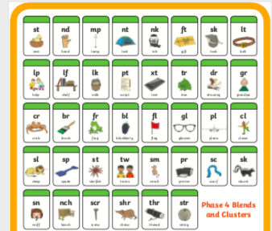
Flashcard/ Sound Recap

Slide 4
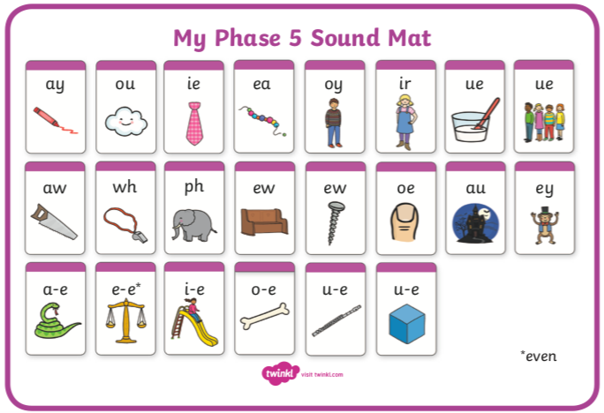
Flashcard/ Sound Recap (your child may not know any of phase 5 yet)

Slide 5
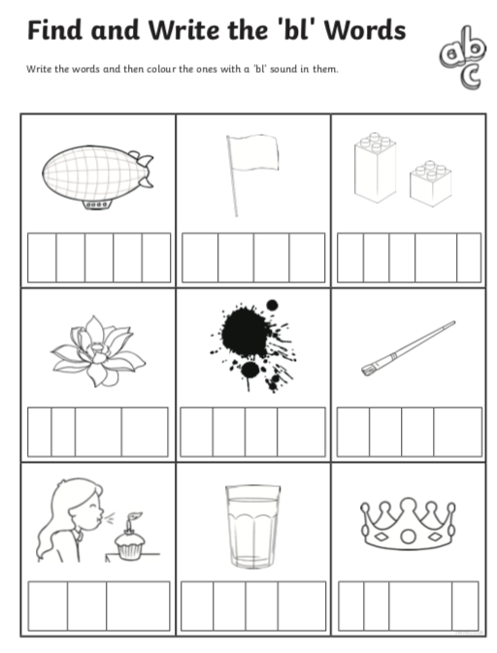

Slide 6
Tuesday
Revisit the sound slides from Monday

Slide 7
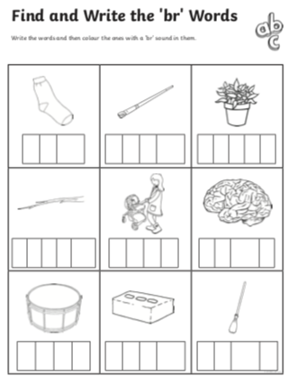

Slide 8
Wednesday
Revisit the sound slides from Monday

Slide 9
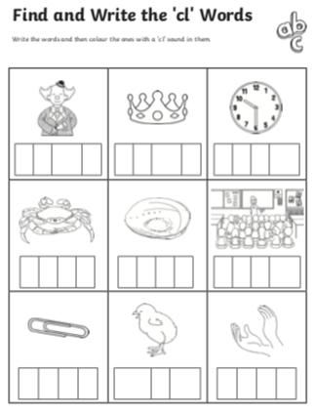

Slide 10
Thursday
Revisit the sound slides from Monday

Slide 11
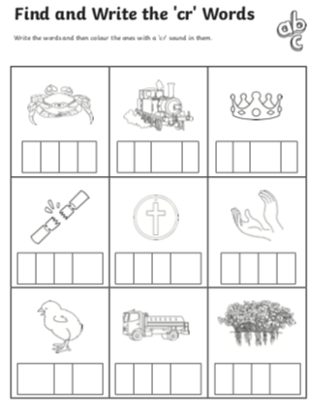

Slide 12
Friday
Revisit the sound slides from Monday

Slide 13
