Slide 2
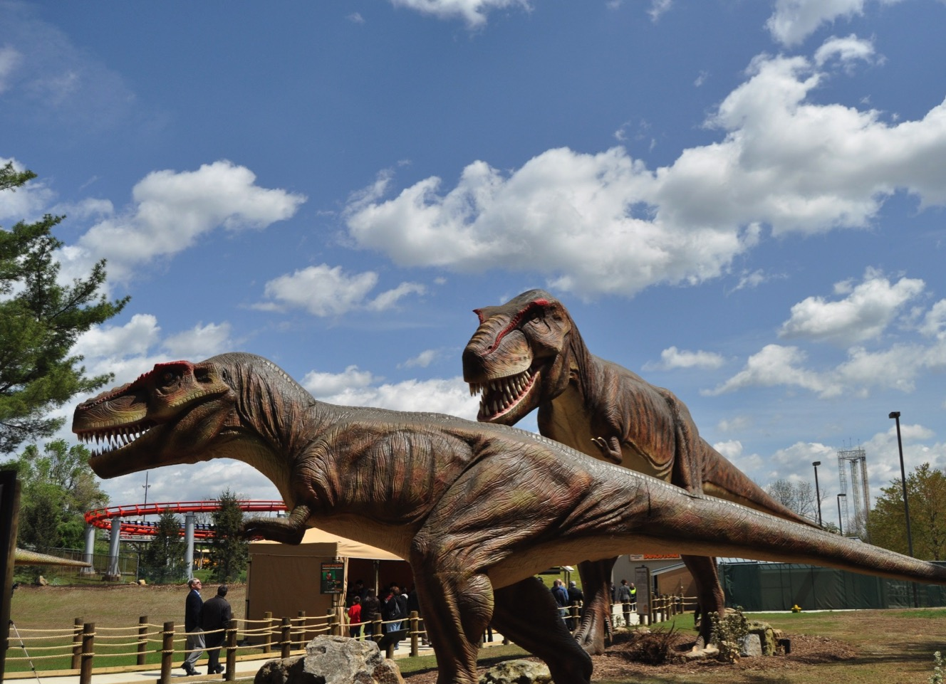
W
Name: Tyrannosaurus Rex
Pronunciation: Ti-ran-o-sor-us Rex
Photo courtesy of Lehigh Valley, PA(@flickr.com) - granted under creative commons licence – attribution

Slide 3
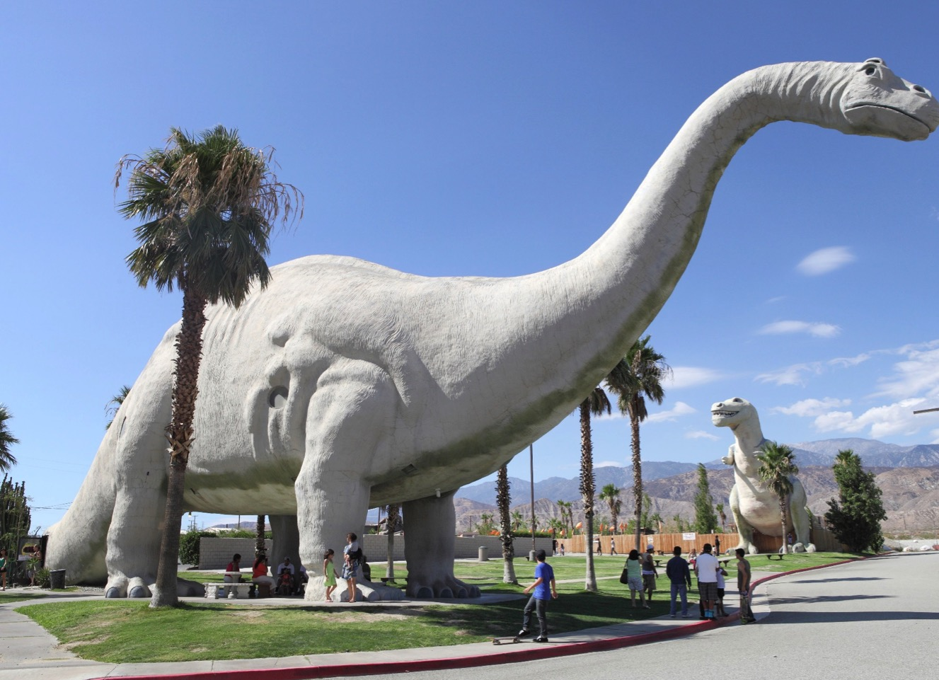
W
Name: Apatosaurus
Pronunciation: A-pat-o-sor-us
Photo courtesy of Sam Howzit(@flickr.com) - granted under creative commons licence – attribution

Slide 4
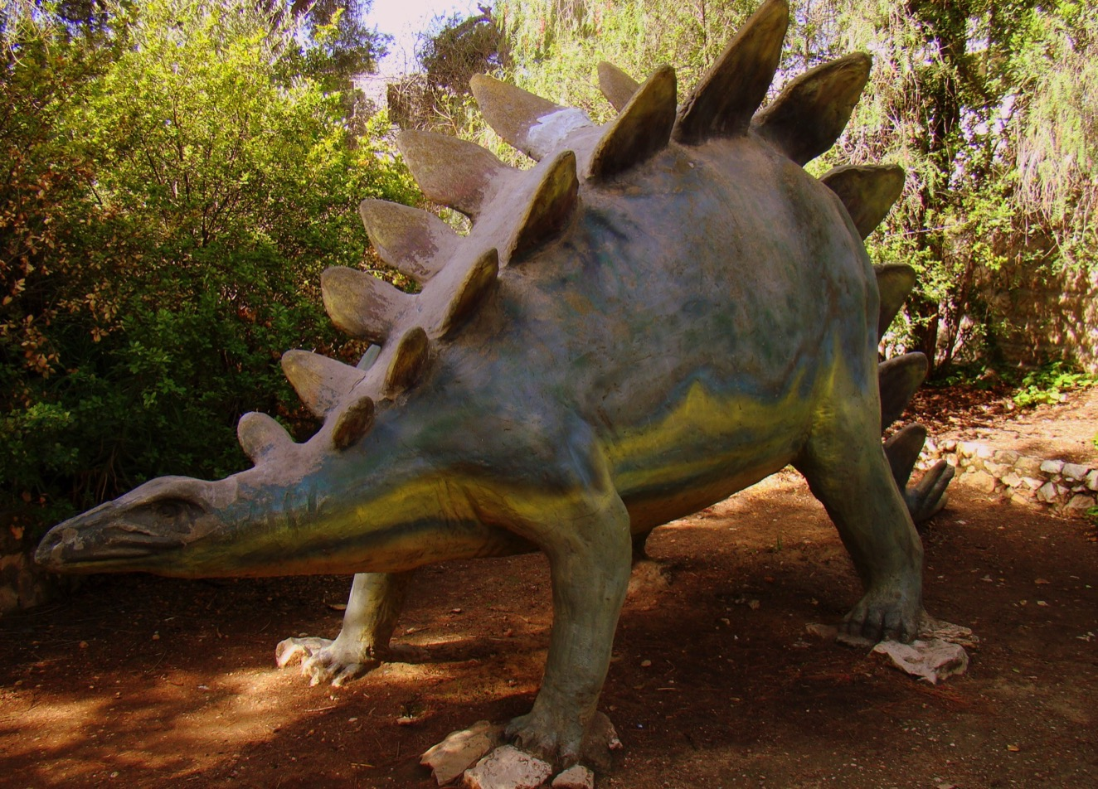
W
Name: Stegosaurus
Pronunciation: Steg-o-sor-us
Photo courtesy of ForestForTrees(@flickr.com) - granted under creative commons licence – attribution

Slide 5
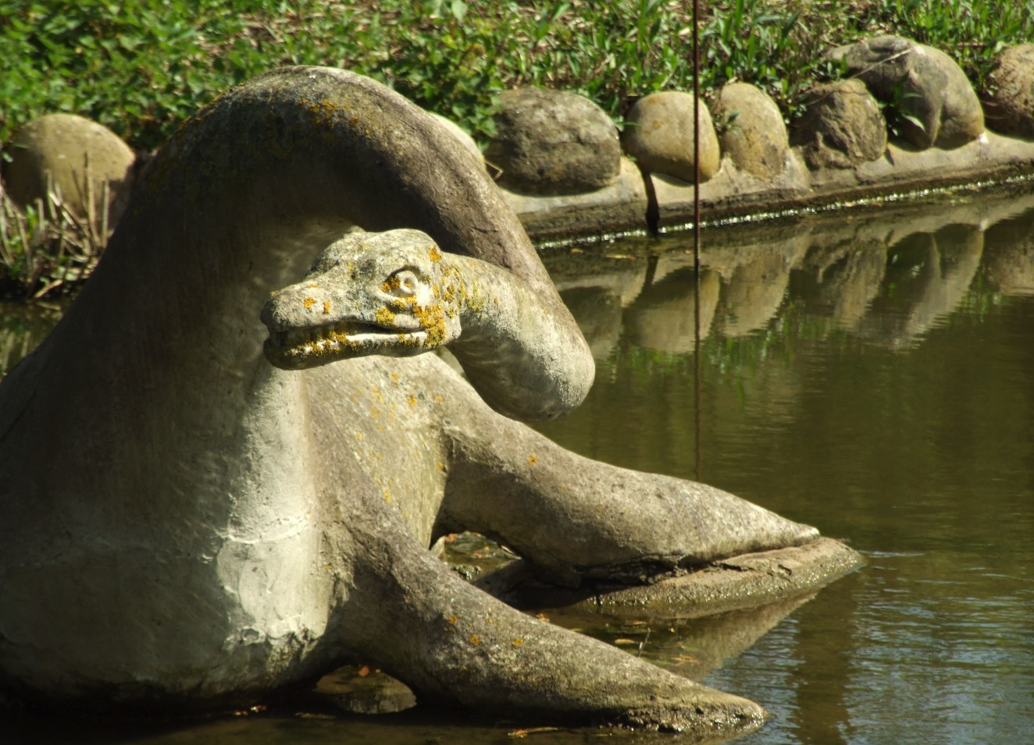
W
Name: Plesiosaurus
Pronunciation: Plee-see-o-sor-us
Photo courtesy of failing_angel(@flickr.com) - granted under creative commons licence – attribution

Slide 6
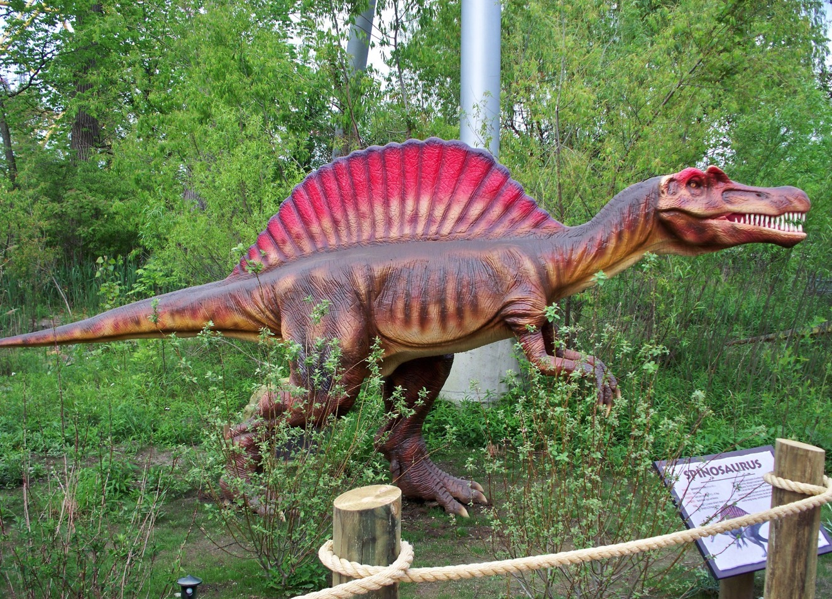
W
Name: Spinosaurus
Pronunciation: Spine-o-sor-us
Photo courtesy of Andrew 94(@flickr.com) - granted under creative commons licence – attribution

Slide 7
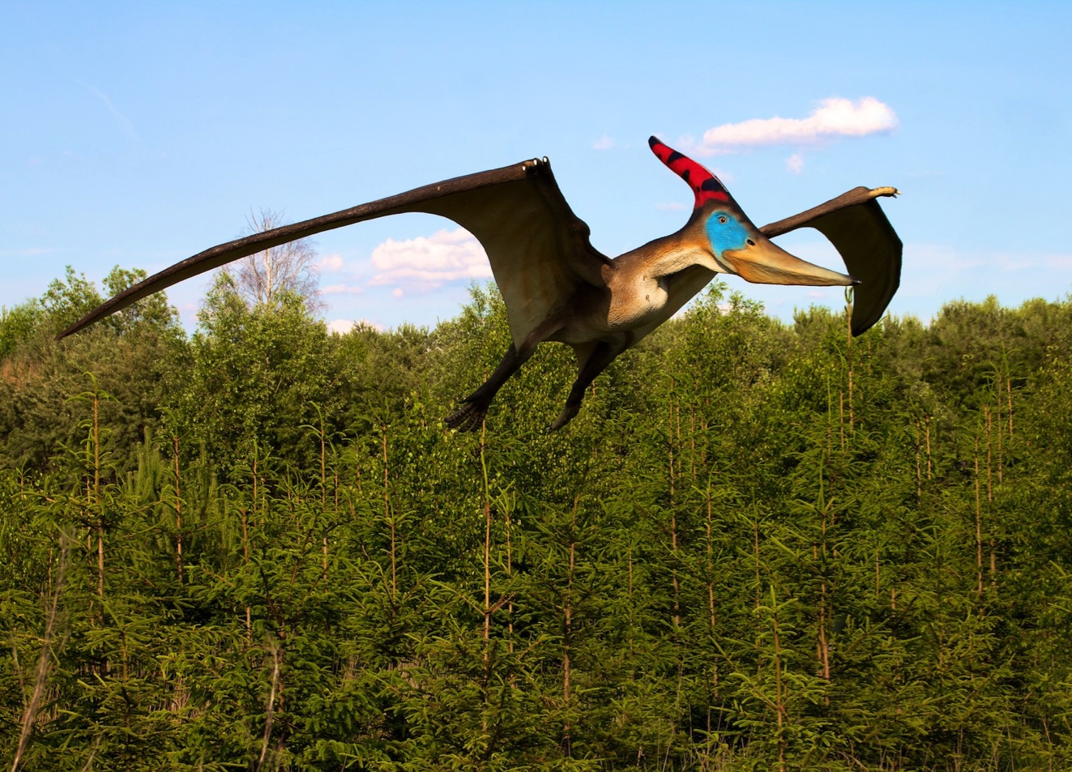
Name: Pteranodon
Pronunciation: Ter-an-o-don
Photo courtesy of paukerman(@flickr.com) - granted under creative commons licence – attribution

Slide 8
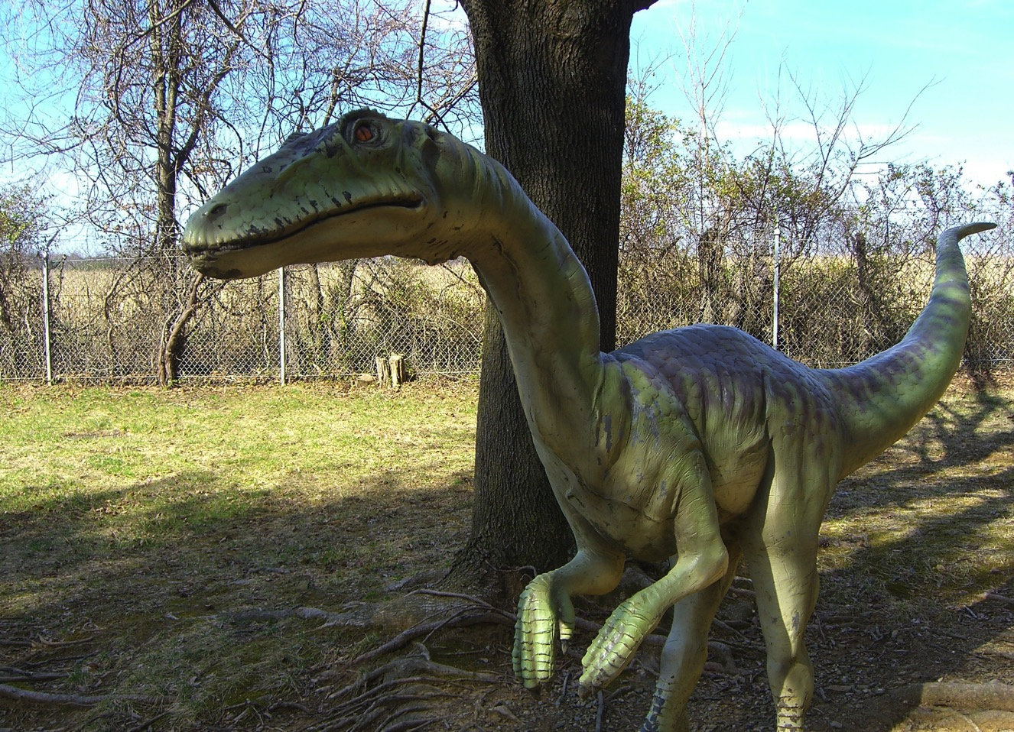
Name: Coeliophysis
Pronunciation: See-lo-fi-sis
Photo courtesy of A.M. Kuchling(@flickr.com) - granted under creative commons licence – attribution

Slide 9
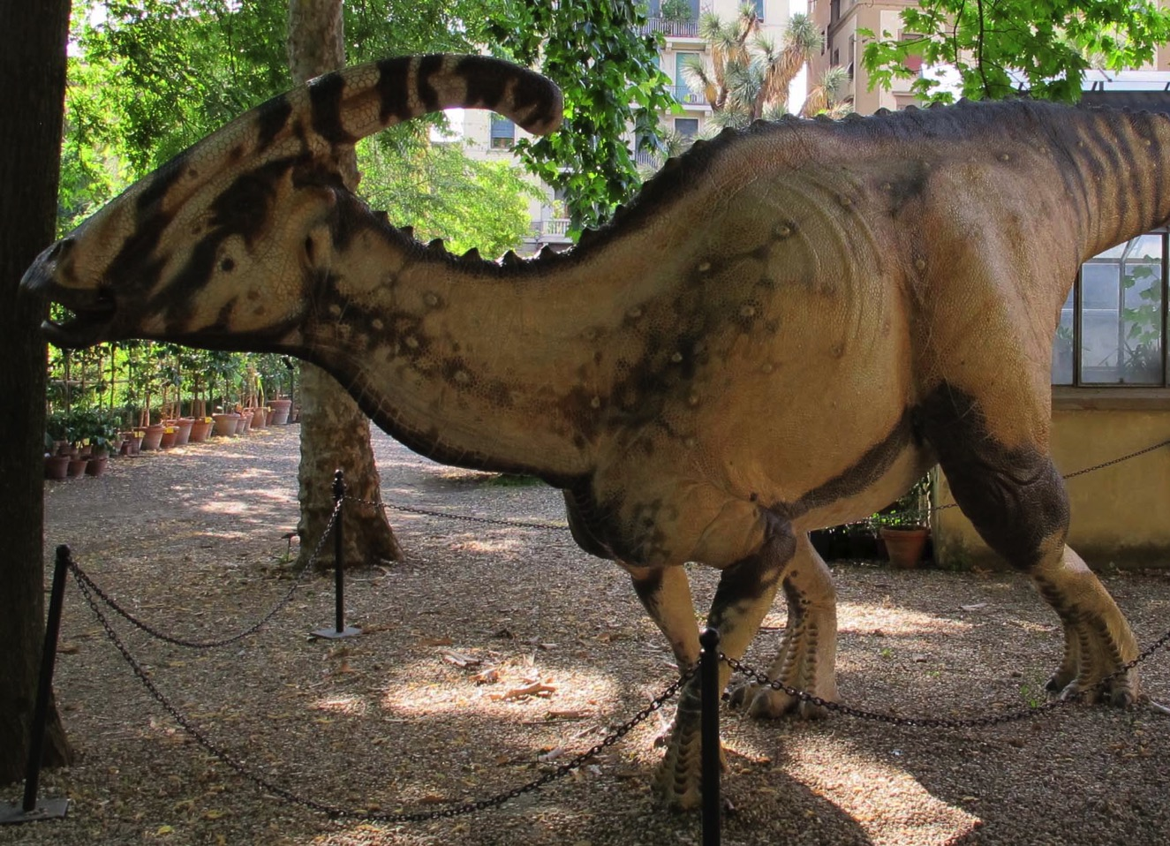
Name: Parasaurolophus
Pronunciation: Pa-ra-sor-ol-o-fus
Photo courtesy of Wikipedia.com- granted under creative commons licence – attribution

Slide 10
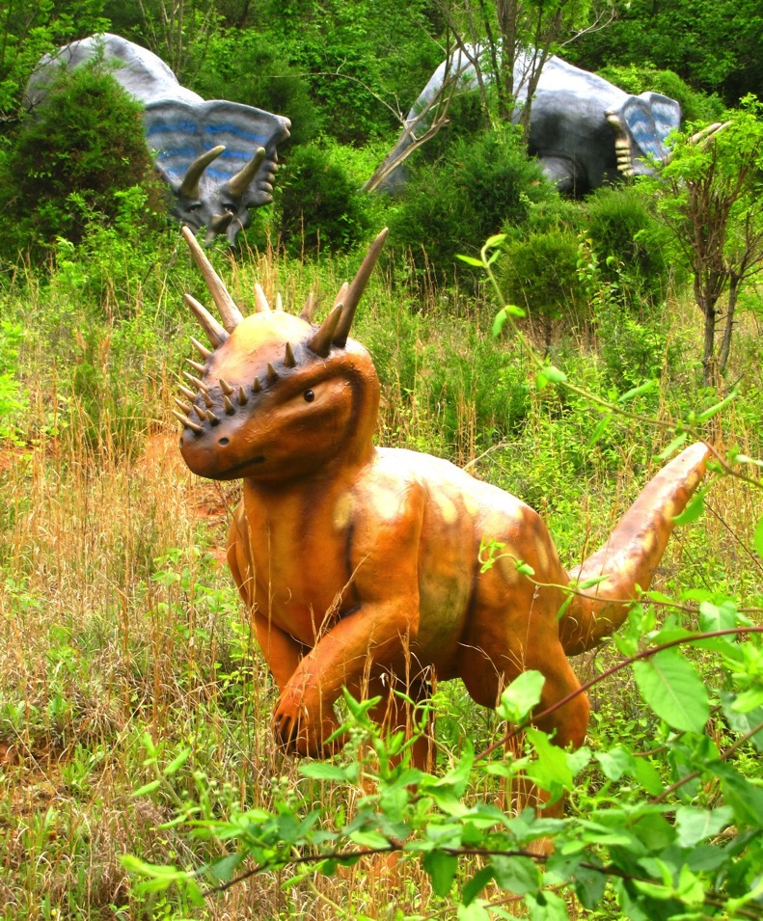
Name: Stygimoloch
Pronunciation: Stij-ee-mol-ock
Photo courtesy of London Looks(@flickr.com)- granted under creative commons licence – attribution

Slide 11
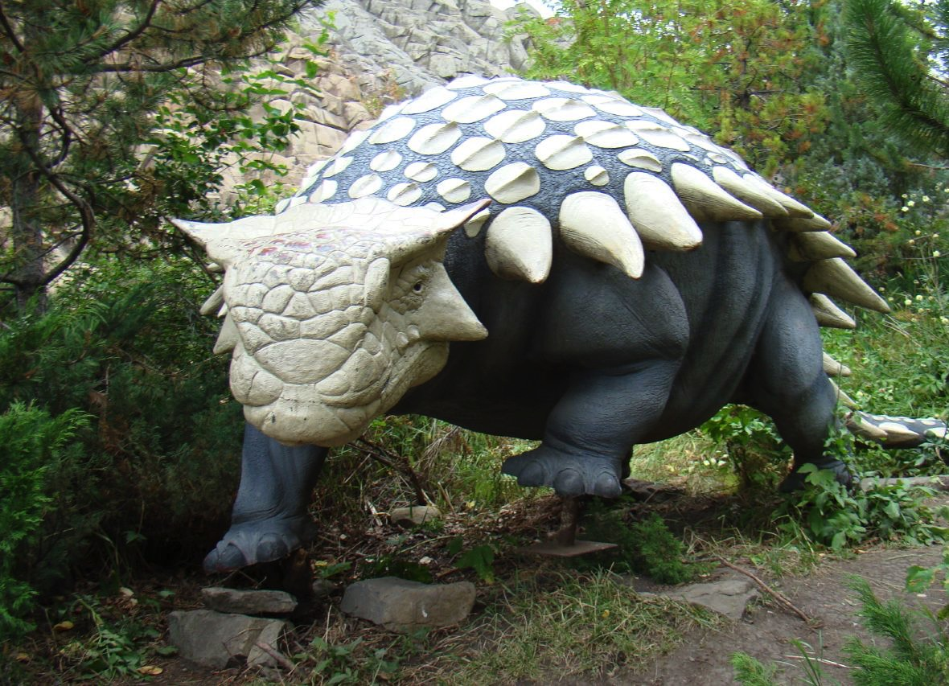
Name: Ankylosaurus
Pronunciation: An-kil-o-sor-us
Photo courtesy of ubermoogle2006(flickr.com)- granted under creative commons licence – attribution

Slide 12
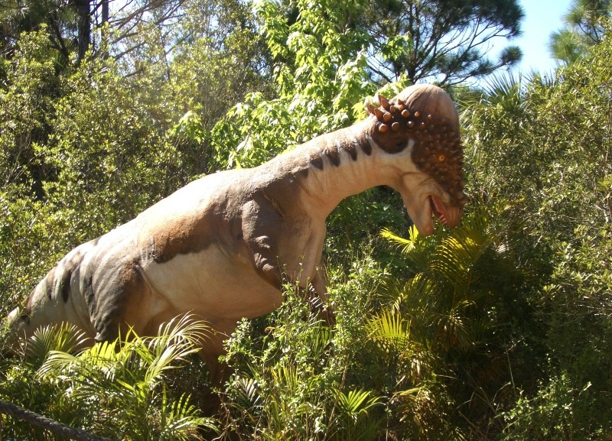
Name: Pachycephalosaurus
Pronunciation: Pack-ee-sef-a-lo-sor-us
Photo courtesy of ubermoogle2006(flickr.com)- granted under creative commons licence – attribution

Slide 13
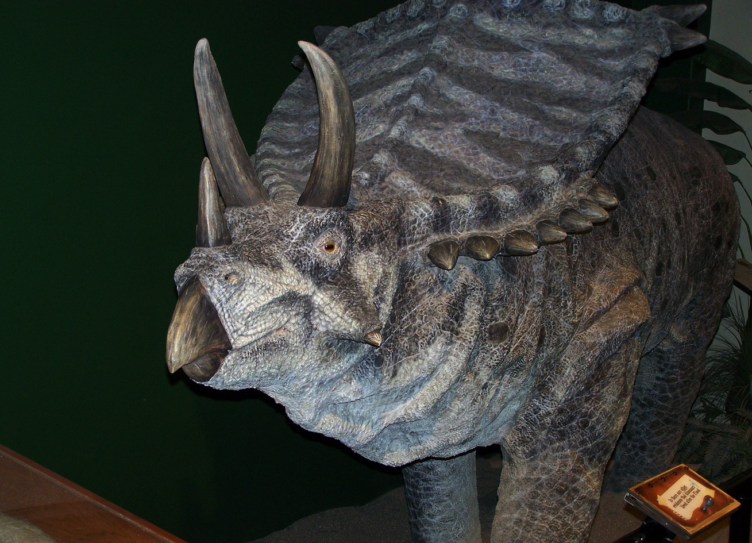
Name: Triceratops
Pronunciation: Try-sera-tops

Slide 14
Name: Diplodocus
Pronunciation: Dip-lo-do-cus
Photo courtesy of sabreguy29 (@flickr.com) - granted under creative commons licence – attribution

