Slide 1
Wednesday

Slide 2
Flashcard/ Sound Recap

Slide 3
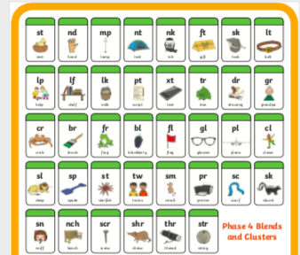
Flashcard/ Sound Recap

Slide 4
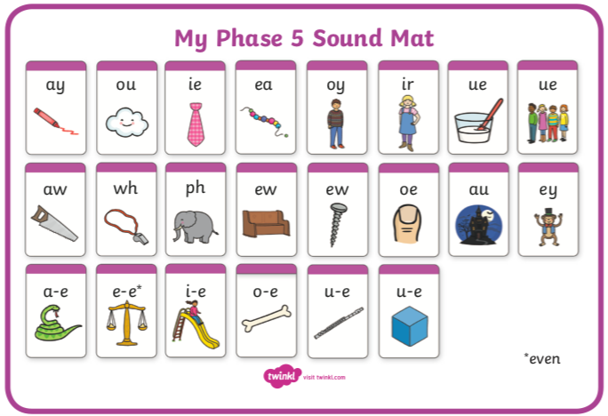
Flashcard/ Sound Recap (your child may not know any of phase 5 yet)

Slide 5
shampoo

Slide 6
giftbox

Slide 7
shelter

Slide 8
sandwich

Slide 9
Read this alien word
If you’d like draw the alien!
relund

