Slide 1
Tuesday

Slide 2
Flashcard/ Sound Recap

Slide 3
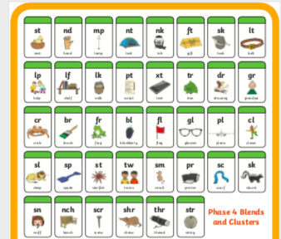
Flashcard/ Sound Recap

Slide 4
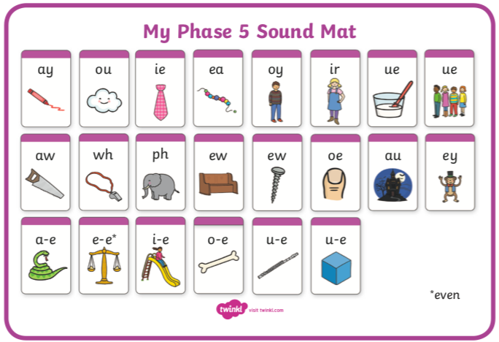
Flashcard/ Sound Recap (your child may not know any of phase 5 yet)

Slide 5
desktop

Slide 6
handstand

Slide 7
melting

Slide 8
lunchbox

Slide 9
Read this alien word
If you’d like draw the alien!
zunper

