Slide 1
Friday

Slide 2
Flashcard/ Sound Recap

Slide 3
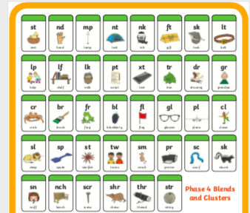
Flashcard/ Sound Recap

Slide 4
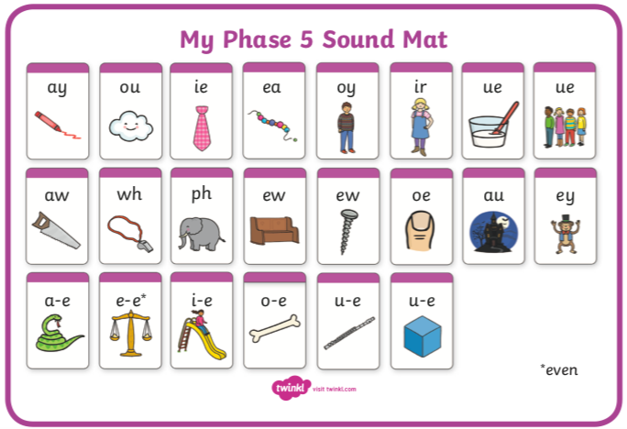
Flashcard/ Sound Recap (your child may not know any of phase 5 yet)

Slide 5
helpdesk

Slide 6
softest

Slide 7
giftbox

Slide 8
Read this alien word
If you’d like draw the alien!
kooft

