Slide 1
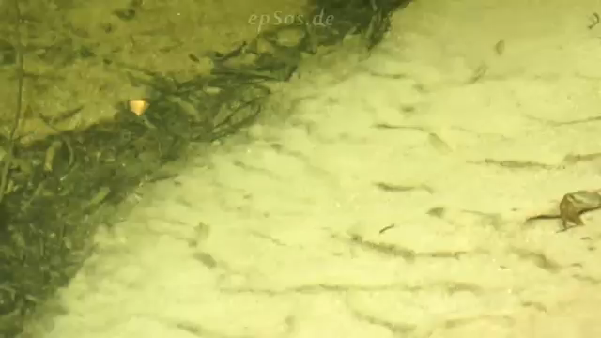
Video courtesy of Judith Kearney(@Youtube.com) - granted under creative commons licence - attribution

Slide 2
What habitats do fish live in?
Which fish live in the
different habitats?

