Slide 1
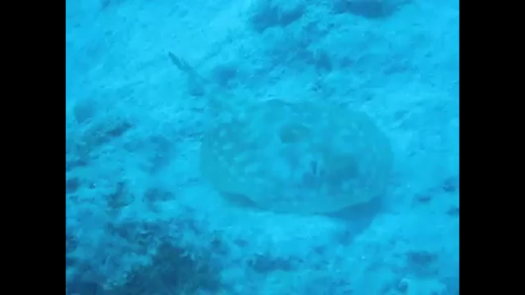
Video courtesy of Judith Kearney(@Youtube.com) - granted under creative commons licence - attribution

Slide 2
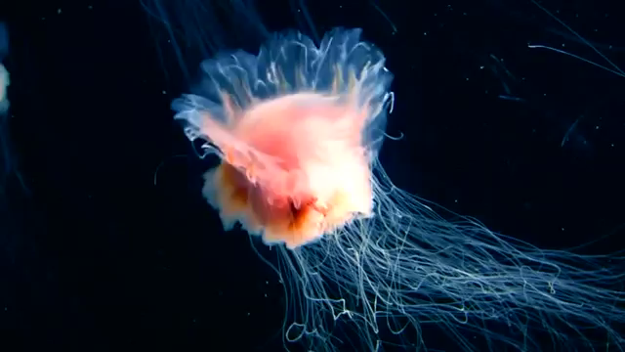
Video courtesy of Judith Kearney(@Youtube.com) - granted under creative commons licence - attribution

