Slide 1
The Pyramids of Giza
By Lottie Hayes

Slide 2
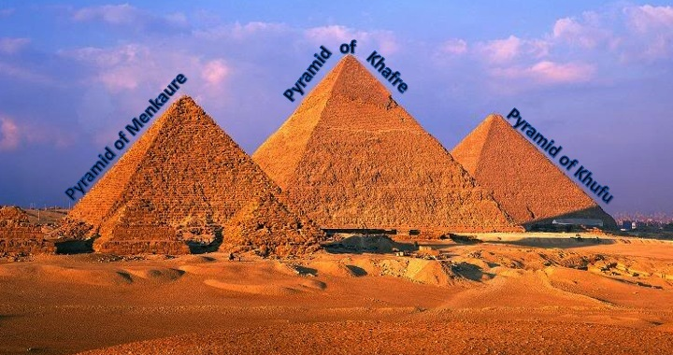

Slide 3
Pyramids of Giza
The Pyramids of Giza are one of the seven wonders of the world they were built in the 26th Century BC.
There are 3 pyramids within this monument Menkaure, Khafre and Khufu. This great monument stands at 348 meters when all three are stacked.

Slide 4
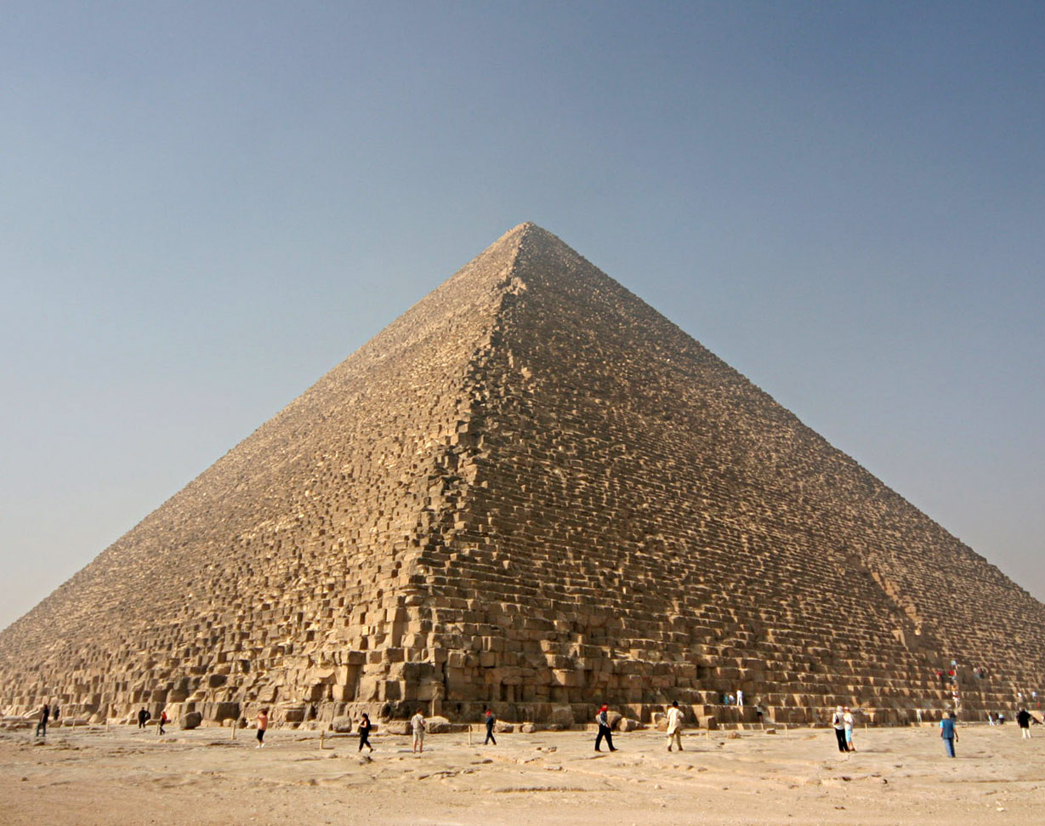
Pyramid of Khufu
The Pyramid of Khufu was built in the year 2589 BC. It is 147 meters this meant it was the tallest man-made structure for about 3,800 years. It was built in over twenty years. It is home to the Pharaoh Khufu who lived for sixty three years.

Slide 5
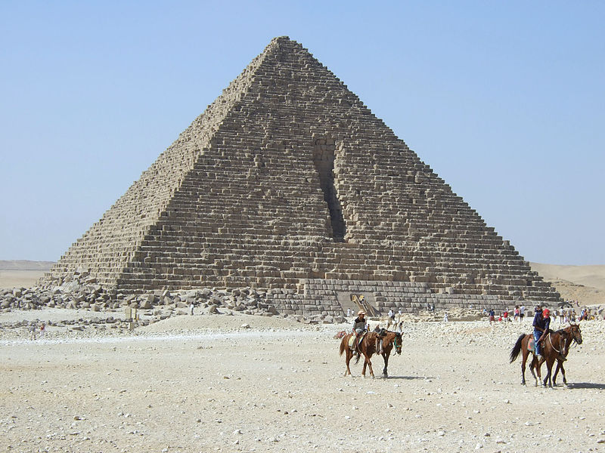
Pyramid of Menkaure
The pyramid of Menkaure was built in the year 2490 BC it is 65 meters tall. It was constructed over a seventeen years. It is the smallest pyramid of Giza. It was home to the Pharaoh Menkaure who lived for twenty eight years.

Slide 6
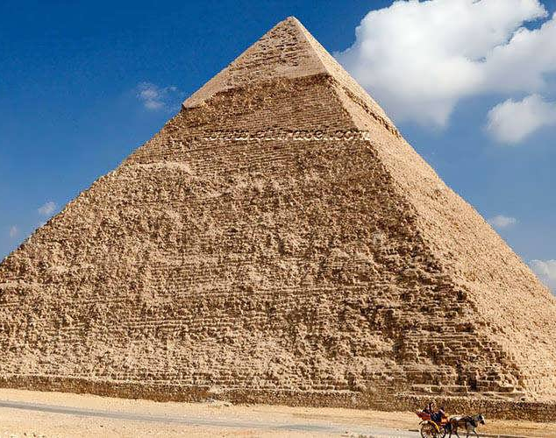
Pyramid of Khafre
The Pyramid of Khafre was built in the year 2540 BC it is 136 meters tall. It took twenty years to build. It is home to the Pharaoh Khafre who lived for twenty eight years.

