Slide 1
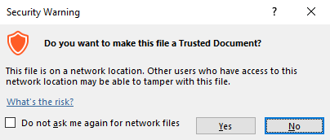
Guidance for Macros in PowerPoints
We use macros within PowerPoints to increase the interactivity of our presentations. Follow this simple process to get the most out of this resource.
What to do:
Open the PowerPoint file and enable editing.
A security warning box may appear. Click yes.
Click enable content.
Enter presentation mode (start the slide show).

Slide 2
Computing
Scratch Developing Games
Year One
Computing | Year 5 | Scratch Developing Games | Splat Game | Lesson 4

Slide 4
Aim
I can create an original animated game with a specific goal.
Success Criteria
I can create appropriate backdrops and sprites.
I can plan sequences of instructions (an algorithm).
I can translate logical instructions into coding language (blocks).
I can test for errors and debug a code.

Slide 5
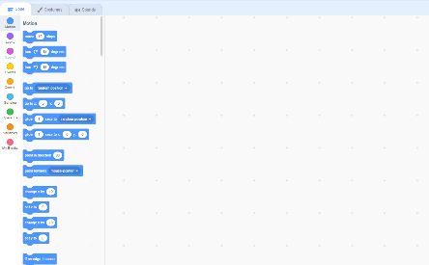
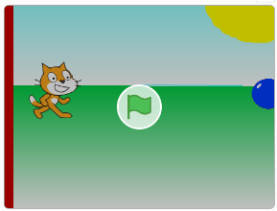
Splat Game
Imagine the instructions and code required for this game to work.
What does the character sprite do?
What does the water balloon do?

Slide 6
New Backdrop
To begin creating the game for yourself, firstly a new backdrop is required.
You can design it however you wish, as long as there is a ‘wall’ made from a rectangle on the left-hand side and the colour will match part of the code later.
The rest of the backdrop could include sky, grass and sun or other ideas.

Slide 7
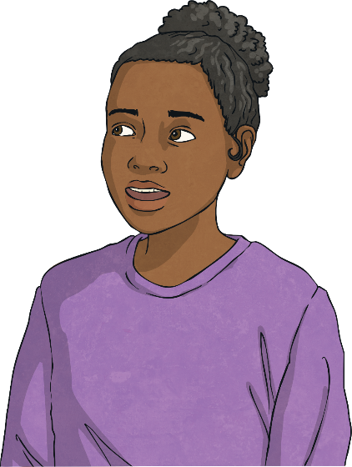
New Sprite
If you’re stuck, start with a big ellipse shape.
Then, add a smaller ellipse to overlap.
The character sprite can stay the same for now but the water balloon is a new sprite that needs to be drawn.
Can you draw your own balloon and choose a colour for it?
Give it an appropriate name.
Use the brush to add a little light reflection as a finishing touch.
Use the brush tool to add a knot at the end.

Slide 8
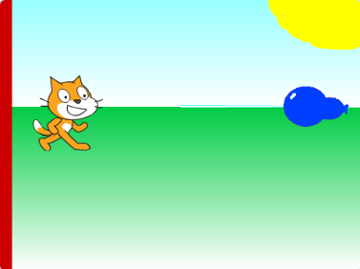
Time to Create!
Now, try creating your own backdrop and water balloon sprite.
Don’t worry about any code yet, just make this part of your game look more interesting and exciting.

Slide 9
The Algorithm
Try thinking through the instructions logically in regular language first of all, then ‘translating’ into coding language.
What do we want the balloon to do?
Move gradually across the screen from right to left until it hits either the sprite or wall and repeat desired number of times.
What do we want the character to do?
‘Jump’ on command. This could be broken down into moving up by a given number, waiting briefly in the air, then moving the same number back down again.

Slide 10
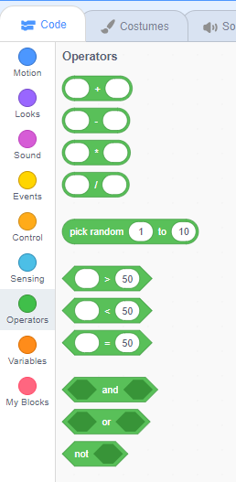
Using Operators
Look at the tab for Operators.
These include logic terms such as ‘and’, ‘or’ and ‘not’.
Two events or sensors can be combined in one statement using ‘and’/‘or’.
The opposite of an event or sensor can be achieved using ‘not’.
Try them out if you think they would be useful in your code.

Slide 11
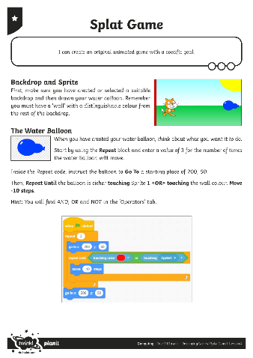
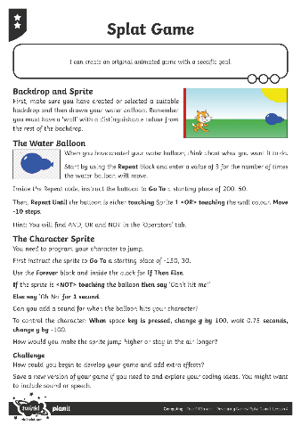
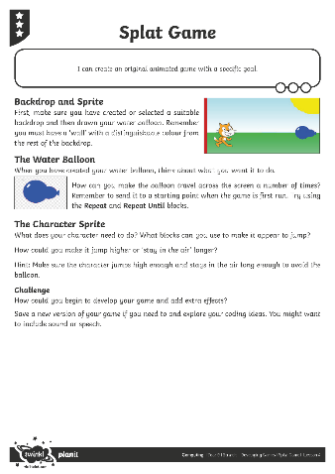
Try It Yourself
Use the Splat Game Activity Sheet to try writing and developing your own code.
Each person’s individual solution might be different – there’s not just one ‘right way’ of doing it so try things out, then edit and improve.

Slide 12
Play the Game
Make sure you have saved your file ‘Splat Game’.
Compare games and coding solutions with other children in the class.
Try out each other’s games to see if they act as expected.
Test and debug the code.
Can you suggest the possible next steps for this game?

Slide 13
Aim
I can create an original animated game with a specific goal.
Success Criteria
I can create appropriate backdrops and sprites.
I can plan sequences of instructions (an algorithm).
I can translate logical instructions into coding language (blocks).
I can test for errors and debug a code.

