Slide 1
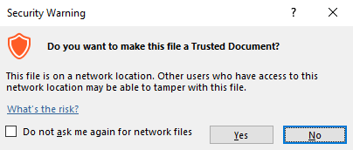
Guidance for Macros in PowerPoints
We use macros within PowerPoints to increase the interactivity of our presentations. Follow this simple process to get the most out of this resource.
What to do:
Open the PowerPoint file and enable editing.
A security warning box may appear. Click yes.
Click enable content.
Enter presentation mode (start the slide show).

Slide 2
Computing
Scratch Developing Games
Year One
Computing | Year 5 | Scratch Developing Games | Scoring and Levels | Lesson 6

Slide 4
Aim
I can add point-scoring and levels to game code.
Success Criteria
I can identify new features to be added to a game.
I can create a variable.
I can use code to increase the value of a variable.
I can add relevant messages that are linked to a final value.

Slide 5
Review the Game
Let’s review the status of the game so far.
What features have now been added and what is missing?
Your first task will be to add in any features from the last lesson that have not yet been completed in your game.

Slide 6
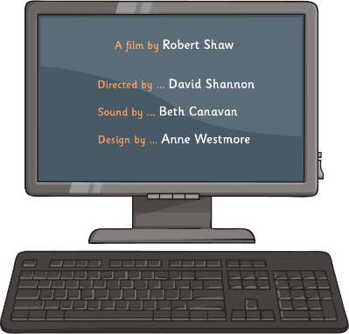
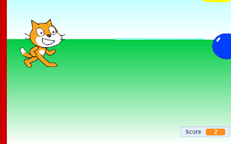
Point-Scoring
How will points be scored in the game?
The character must successfully jump over each oncoming water balloon.
How will the computer code recognise that this has happened?
One way is to count each time the balloon hits the wall, as the character must have therefore avoided being hit.

Slide 7
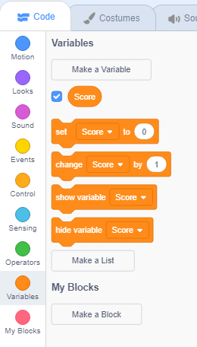
Making a Variable
Click on Make a Variable, name it ‘Score’ and add ‘Set Score to 0’ at the beginning of the game.
We can make our own variable by clicking on the Variables option in the Code tab.

Slide 8
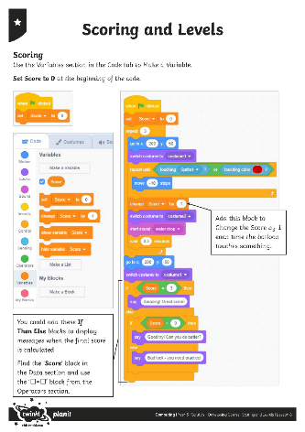
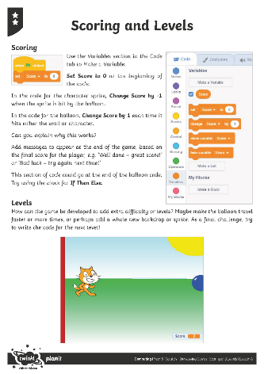
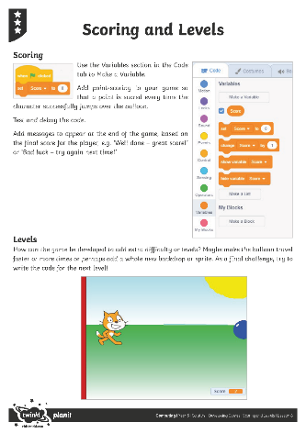
Try It Yourself
Now, see if you can add scoring to your game by increasing the ‘Score’ variable every time the character jumps the balloon.
Use the Scoring and Levels Activity Sheet to help.

Slide 9
Play the Game
Make sure you have saved your file ‘Splat Game v3’.
Compare games and coding solutions with other children in the class.
Try out each other’s games to see if they act as expected.
Test and debug the code.
Can you suggest the possible next steps for this game?

Slide 10
Aim
I can add point-scoring and levels to game code.
Success Criteria
I can identify new features to be added to a game.
I can create a variable.
I can use code to increase the value of a variable.
I can add relevant messages that are linked to a final value.

