Slide 1
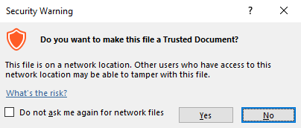
Guidance for Macros in PowerPoints
We use macros within PowerPoints to increase the interactivity of our presentations. Follow this simple process to get the most out of this resource.
What to do:
Open the PowerPoint file and enable editing.
A security warning box may appear. Click yes.
Click enable content.
Enter presentation mode (start the slide show).

Slide 2
Computing
Scratch Developing Games
Year One
Computing | Year 5 | Scratch Developing Games | Maze Game | Lesson 1

Slide 4
Aim
I can design and program a character game.
Success Criteria
I can draw a background using blocks to make a maze.
I can select and change a character (sprite).
I can program commands that control the movement of a sprite.
I can program consequences for specific actions.

Slide 5
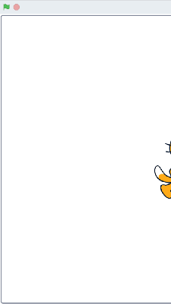
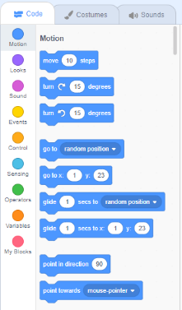
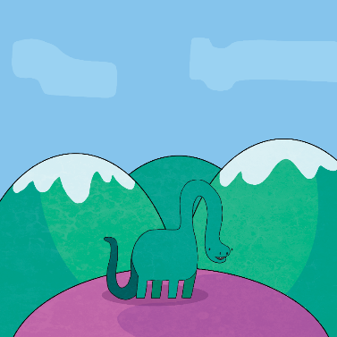
Scratch Recap
Can you remember these key features for programming and using Scratch?
sprite
backdrop
blocks (scripts)

Slide 6
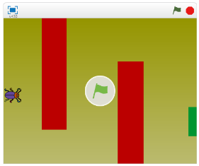
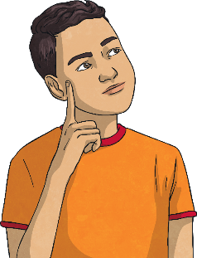
The Maze Game
Click on the image to run the maze game.
The aim of the game is to reach the green exit without touching the red obstacles.
How does the user make the character move?
What happens if a red obstacle is touched?
What happens when the green exit is reached?

Slide 7
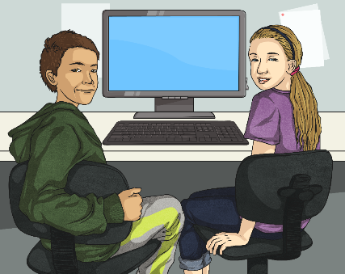
Writing an Algorithm
An algorithm does not have to be written in computer code.
It is just a set of instructions that explain how to do something.
Work together to design an algorithm using the Activity Sheet which explains how the Maze Game should work.
You can use commands, notes and even illustrations to help you plan the instructions.

Slide 8
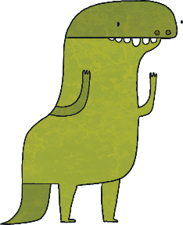
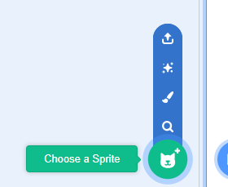
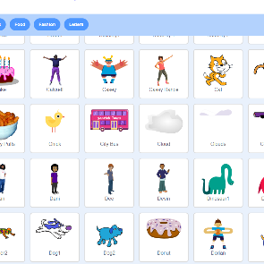
Choosing a Character
You can choose a new sprite as the character for your game or even design your own.
To choose a new sprite, click on the button underneath the main backdrop, next to ‘New Sprite’.
A library of options appears from which to choose your sprite. Make your selection and click OK.
Your new sprite will appear in the Sprites box near the bottom left of the screen.

Slide 9
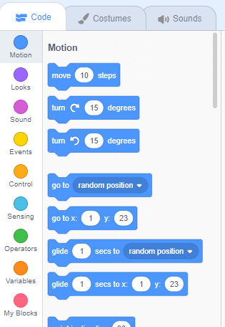
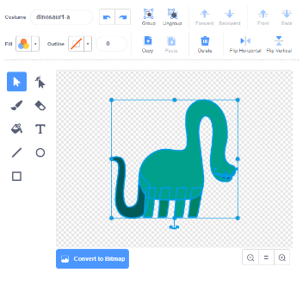
Resizing a Character
You may need to resize your sprite and make it smaller.
Click on the Costumes tab at the top of the screen. Your sprite appears in an editor on the right hand side.
To change the size of the sprite, click on the image in the editor to select it.
Use the handles around the edge to resize or rotate.
You can resize specific parts of the sprite by selecting a body part and using the handles to resize.

Slide 10
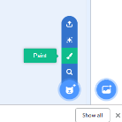
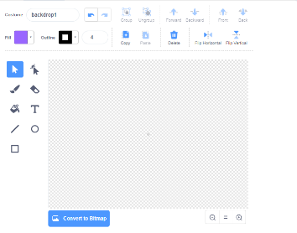
Designing a Backdrop 1
Click on the button for Paint new backdrop.
A new canvas appears on the right for you to draw in.

Slide 11
Designing a Backdrop 2
Use the rectangle shape tool to draw your maze obstacles.
Use the fill tool to colour the objects.
Change colours using the sliders from the fill and outline dropdown menu.
Decide where you want to place your maze obstacles and don’t forget the green exit rectangle.

Slide 12
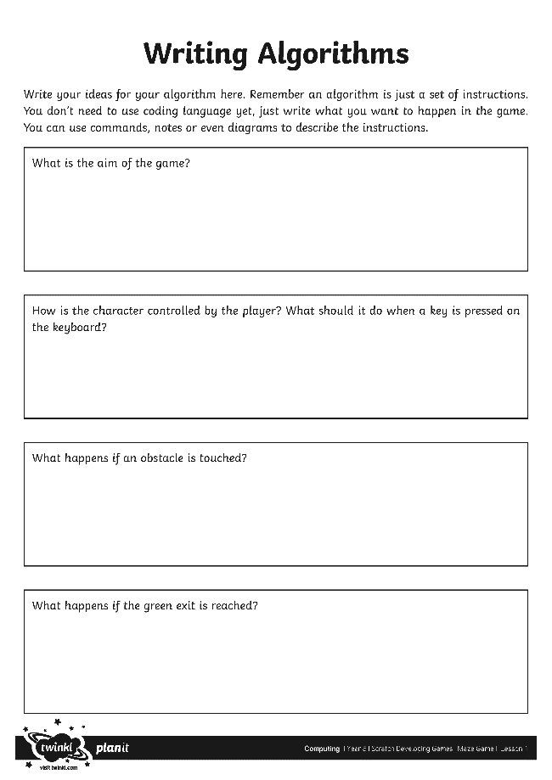
Coding the Maze Game
Now you have your new character and backdrop.
Can you use your written algorithm to design the code for the game?
Try out each of the blocks as you select them.
Keep testing and debugging the game as you go along.
Use the Writing Algorithms Activity Sheet.

Slide 13
Play the Game
Make sure you have saved your file.
Compare games and coding solutions with other children in the class.
Try playing the game to see if it acts as expected. Test and debug the code.
Can you suggest the next steps or any improvements for each version of the game?

Slide 14
Aim
I can design and program a character game.
Success Criteria
I can draw a background using blocks to make a maze.
I can select and change a character (sprite).
I can program commands that control the movement of a sprite.
I can program consequences for specific actions.

