Slide 1
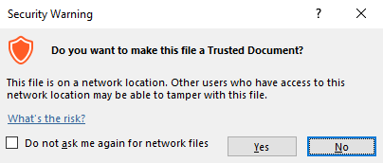
Guidance for Macros in PowerPoints
We use macros within PowerPoints to increase the interactivity of our presentations. Follow this simple process to get the most out of this resource.
What to do:
Open the PowerPoint file and enable editing.
A security warning box may appear. Click yes.
Click enable content.
Enter presentation mode (start the slide show).

Slide 2
Computing
Scratch Developing Games
Year One
Computing | Year 5 | Scratch Developing Games | Characters and Backdrops | Lesson 2

Slide 4
Aim
I can design my own characters and backdrops.
Success Criteria
I can draw a background using blocks to make a more complex maze.
I can use tools to draw my own character (sprite).
I can program commands that change the backdrop.
I can test and debug a program after making changes.

Slide 5
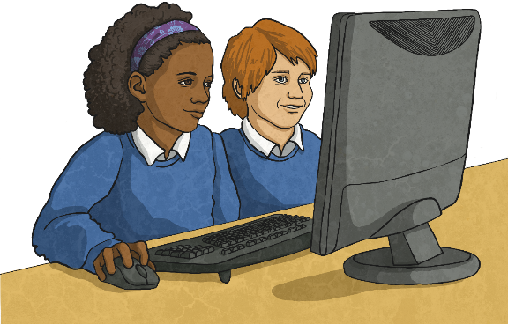
Aim of the Game
Open up your Maze Game from last lesson. What was the aim of the game?
What could be done next to make the game more interesting or exciting?

Slide 6
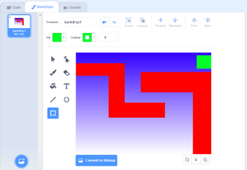
The Next Level
We can design a more complex backdrop to become Level 2 of the Maze Game.
Click on Paint New Backdrop. Edit the titles to label the two backdrops Level 1 and Level 2.
Choose a background colour to use. Can you use a Gradient Fill?
Can you create a more challenging maze backdrop than the last one?

Slide 7
Level Progress
How could the code be adapted to make progress from Level 1 to Level 2?
What does a Player do to complete the first level and what action does this trigger in order to move to the second level?
The sprite must reach the green exit and this triggers the new event of changing to the next backdrop.
The sprite will need to be reset to the starting position and the ‘Well done’ message given a time limit.
You can make any number of gradually more complex levels! How will your game develop?

Slide 8
Develop Your Game
Click on ‘File’ and ‘Save As’ to save a new version of your Maze Game (e.g. Maze Game v2).
Use the Characters and Backdrops Activity Sheet to develop your game by first adding exciting new levels.
Test and debug your code as you make changes.

Slide 9
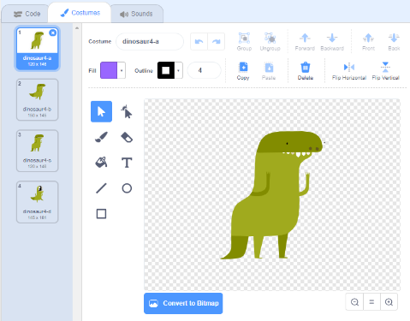
Character Design
Click on Paint New Sprite to open a similar canvas to the backdrop editor.
This time create a simple new character. It could be an enemy for the first sprite.
Can you use the tools for brush, line, ellipse, select (resize) and be able to change the line width?

Slide 10
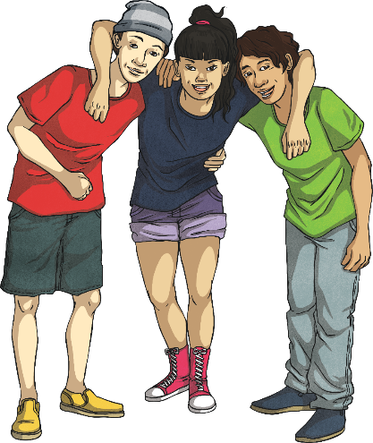
Play the Game
Make sure you have saved your file again.
Compare games and coding solutions with other children in the class.
Try playing each other’s games to see if they act as expected.
Test and debug the code.
Can you suggest the next steps or any improvements for each other’s games?

Slide 11
Aim
I can design my own characters and backdrops.
Success Criteria
I can draw a background using blocks to make a more complex maze.
I can use tools to draw my own character (sprite).
I can program commands that change the backdrop.
I can test and debug a program after making changes.

