Slide 1
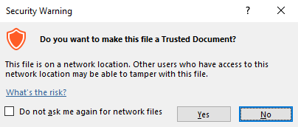
Guidance for Macros in PowerPoints
We use macros within PowerPoints to increase the interactivity of our presentations. Follow this simple process to get the most out of this resource.
What to do:
Open the PowerPoint file and enable editing.
A security warning box may appear. Click yes.
Click enable content.
Enter presentation mode (start the slide show).

Slide 2
Computing
Scratch Developing Games
Year One
Computing | Year 5 | Scratch Developing Games | Changing Costumes | Lesson 5

Slide 4
Aim
I can program costume changes for a sprite.
Success Criteria
I can design new costumes for an existing sprite.
I can design code that switches from one costume to another.
I can add appropriate effects to complement a change of costume.

Slide 5
Initial Game Design
What elements of the game did you manage to create in the last lesson?
What is wrong with the animation of the existing game?
The balloon doesn’t burst.
No sound is made.
Any other ideas?

Slide 6
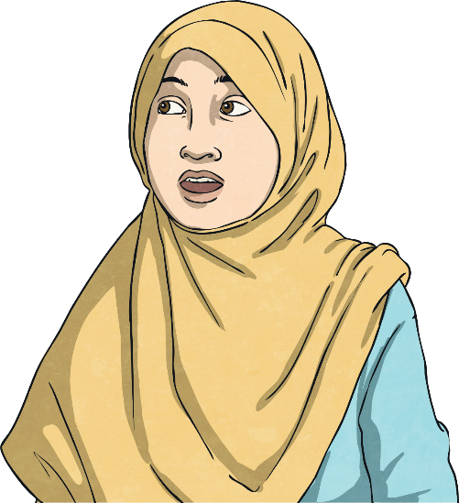
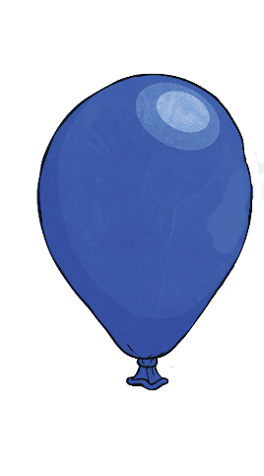
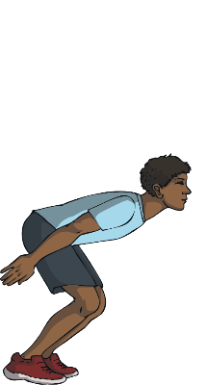
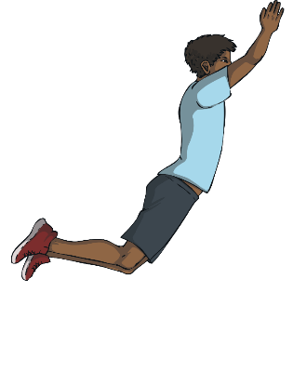
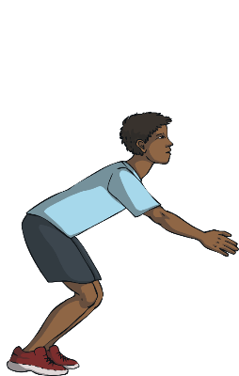
Costumes
For example, the character may look different when jumping and the balloon will look different when it splats!
Each sprite can be animated by changing to a different ‘costume’.
The sprite can have many different looks and can be programmed to change from one to another as a consequence of any particular event.

Slide 7
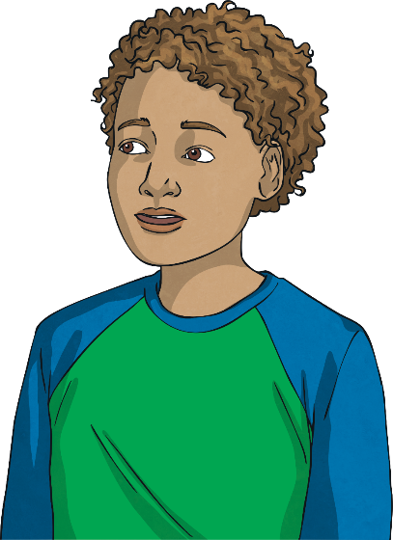
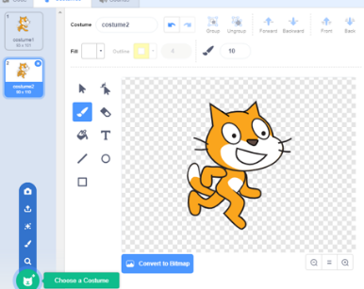
Changing Costumes
Right-click on a sprite and click duplicate.
Some sprites in the library already have different versions that you can select.
In addition, sprites we have created can be edited and new versions saved as new ‘costumes’.
Choose costume from library.
Paint new costume.

Slide 8
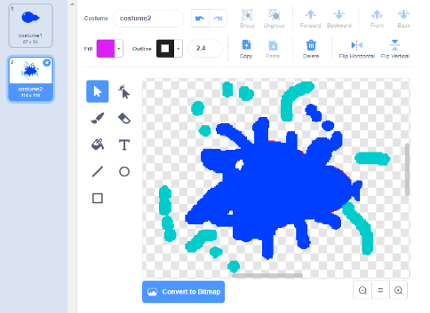
Changing Costumes
Try duplicating the balloon sprite, then editing Costume2 to make the ‘splat’ version!

Slide 9
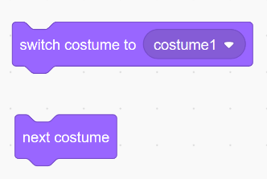
Changing Costumes
In the ‘Looks’ section of the Scripts tab, you can find blocks for ‘next costume’ and ‘switch costume’.
These can be used in your code. What do you think is the difference between them?

Slide 10
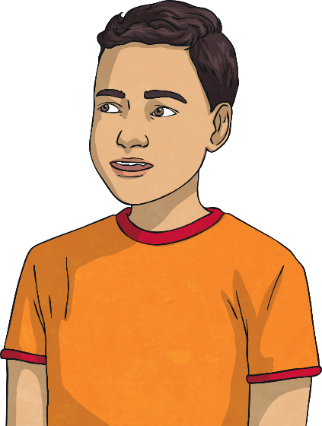
Try It Yourself
Now, see if you can add changing costumes to your code.
Can you make the balloon splat when it hits the character or the wall?

Slide 11
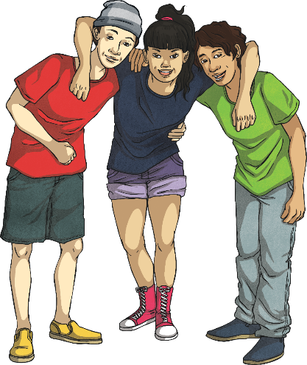
Play the Game
Make sure you have saved your file ‘Splat Game’.
Compare games and coding solutions with other children in the class.
Try out each other’s games to see if they act as expected.
Test and debug the code.
Can you suggest the possible next steps for this game?

Slide 12
Aim
I can program costume changes for a sprite.
Success Criteria
I can design new costumes for an existing sprite.
I can design code that switches from one costume to another.
I can add appropriate effects to complement a change of costume.

