Slide 1
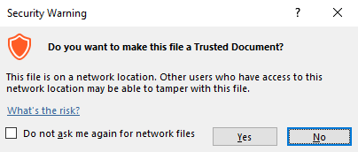
Guidance for Macros in PowerPoints
We use macros within PowerPoints to increase the interactivity of our presentations. Follow this simple process to get the most out of this resource.
What to do:
Open the PowerPoint file and enable editing.
A security warning box may appear. Click yes.
Click enable content.
Enter presentation mode (start the slide show).

Slide 2
Computing
Scratch Developing Games
Year One
Computing | Year 5 | Scratch Developing Games | Adding Effects | Lesson 3

Slide 4
Aim
I can add features or effects to enhance a game.
Success Criteria
I can add appropriate commentary to a code.
I can add sounds as a consequence of an action.
I can create events as a consequence to another action.
I can make two characters move in relation to each other.

Slide 5
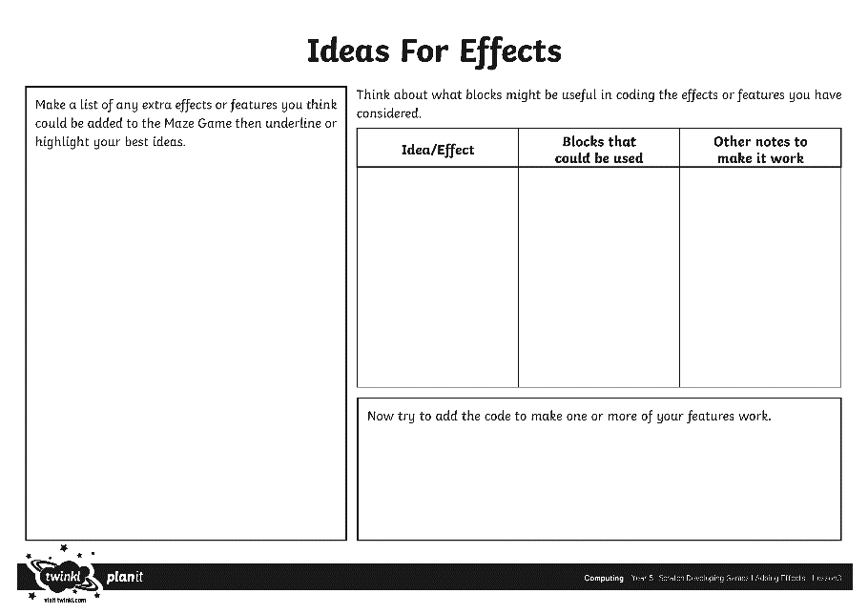
Adding Effects
What other effects could be added to the Maze Game now to enhance the final version?
What would make the game more exciting?
Can you think of the possible code for some of your ideas from this lesson or last time.
Make notes on your activity sheet.

Slide 6
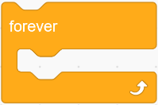
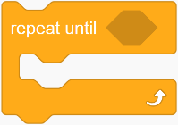
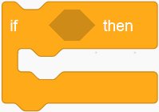
Feedback
Share ideas for adding effects.
Consider the possible coding language and blocks needed to make the ideas work.
What is the effect of using these blocks?

Slide 7
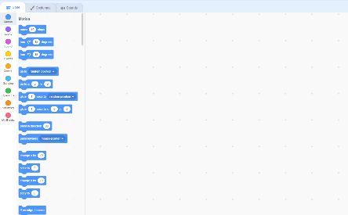
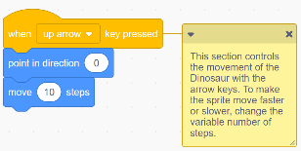
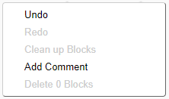
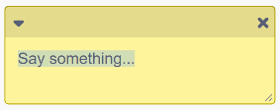
Adding Commentary
One way to improve the effectiveness of your code is to add commentary to blocks.
Brief notes will help to show others how a problem may have been solved or what the intention is for a particular block.
The notes box can be resized by clicking and dragging the bottom right hand corner.
1
You can do this by right-clicking on the block and choosing
‘add comment’.
3
4
2

Slide 8
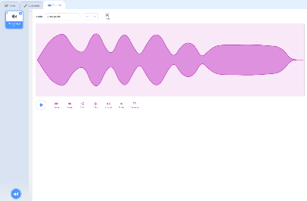
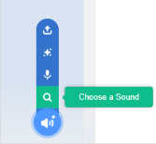
Adding Sounds
Sounds can be played in your code.
To add new sounds, you can choose from the sound library, from another file or by recording your own.
These can then be played as a consequence when another event happens, e.g. the sprite touching the obstacle, exit or enemy.

Slide 9
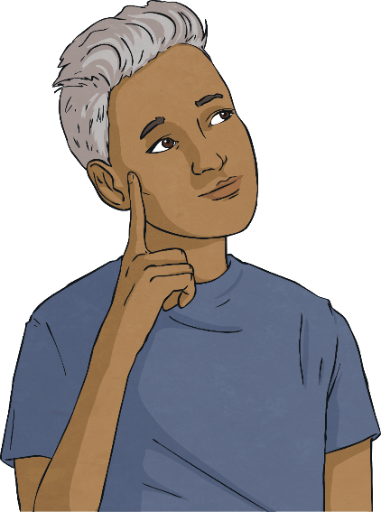
Other Effects
What about sending the sprite back to the beginning when an obstacle is touched?
You could try to animate the enemy sprite (created in the last lesson).
Work together to add these or any of your own additional effects to complete your maze game.

Slide 10
Develop Your Game
Click on ‘File’ and ‘Save As’ to save a new version of your Maze Game (e.g. Maze Game v3)
Use your activity sheet to develop a final version of your game.
Test and debug your code as you make changes.

Slide 11
Play the Game
Make sure you have saved your file again.
Compare games and coding solutions with other children in the class.
Try playing each other’s games to see if they act as expected.
Test and debug the code.
Can you suggest the next steps or any improvements for each other’s games?

Slide 12
Aim
I can add features or effects to enhance a game.
Success Criteria
I can add appropriate commentary to a code.
I can add sounds as a consequence of an action.
I can create events as a consequence to another action.
I can make two characters move in relation to each other.

