Slide 1
Wednesday
How to Play Get Ready to Write!
When you see a picture, think of the word.
Sound out the word to write it.
Check that the sounds you have written make the right word when you blend them together.
Turn your board around as soon as you can so that your teacher can see what you think the word is.
It is very important that you write and show your answer quietly.
If you shout out the answer, somebody else might hear you and put it on their board even quicker than you can!
Home
Start!

Slide 2
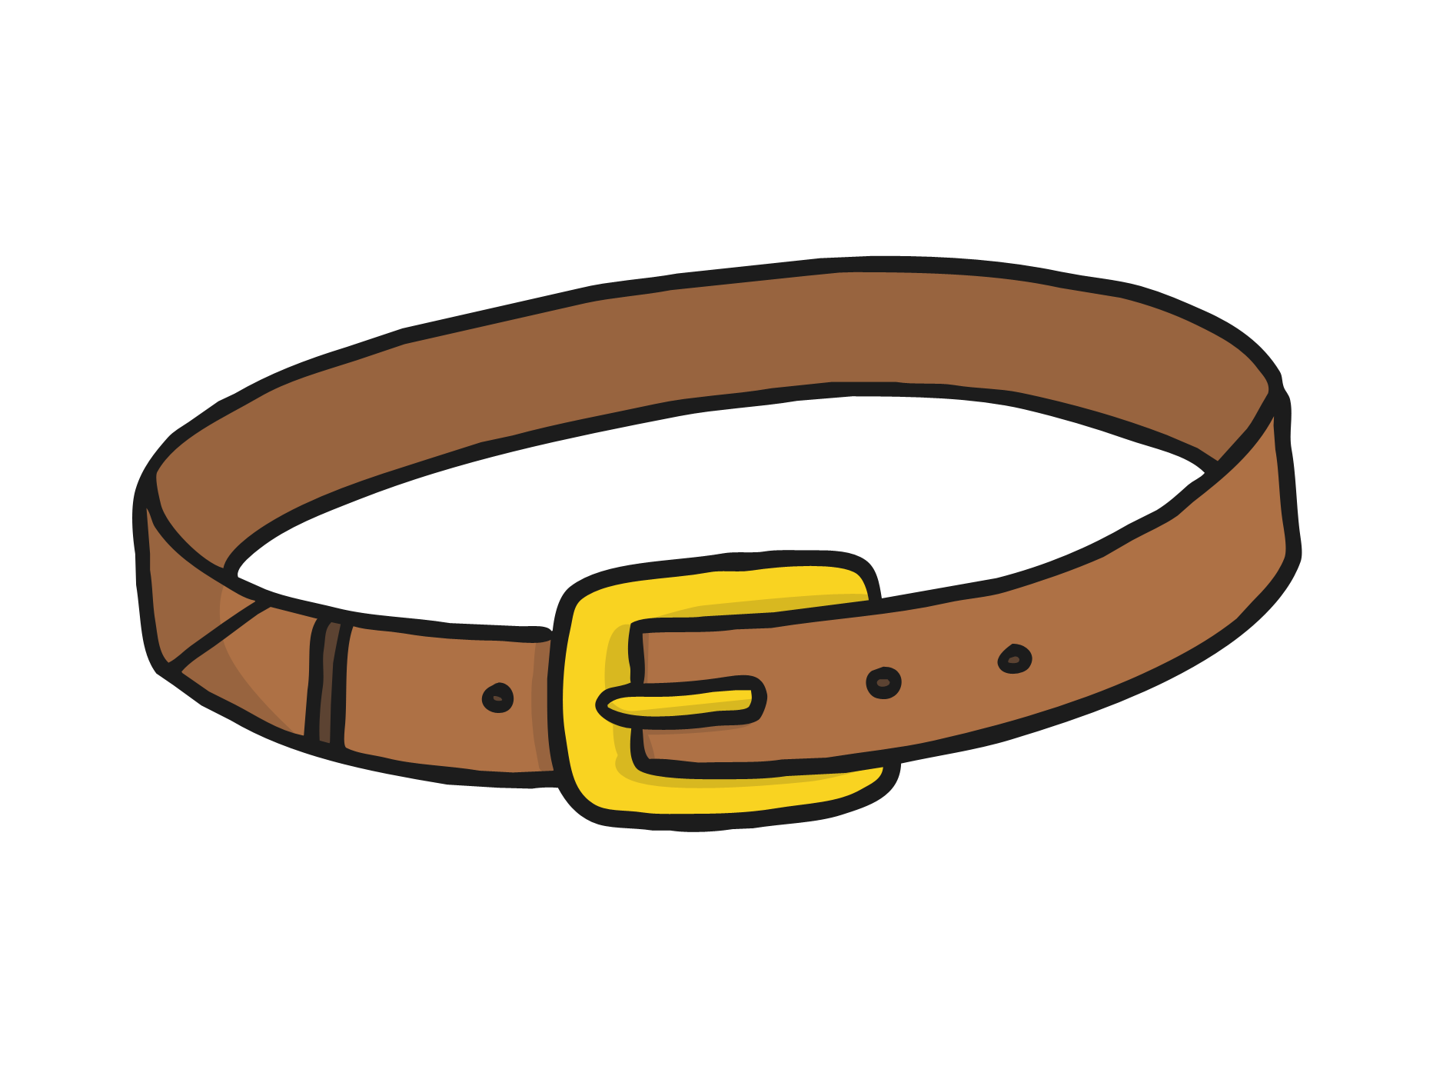
belt
next

Slide 3
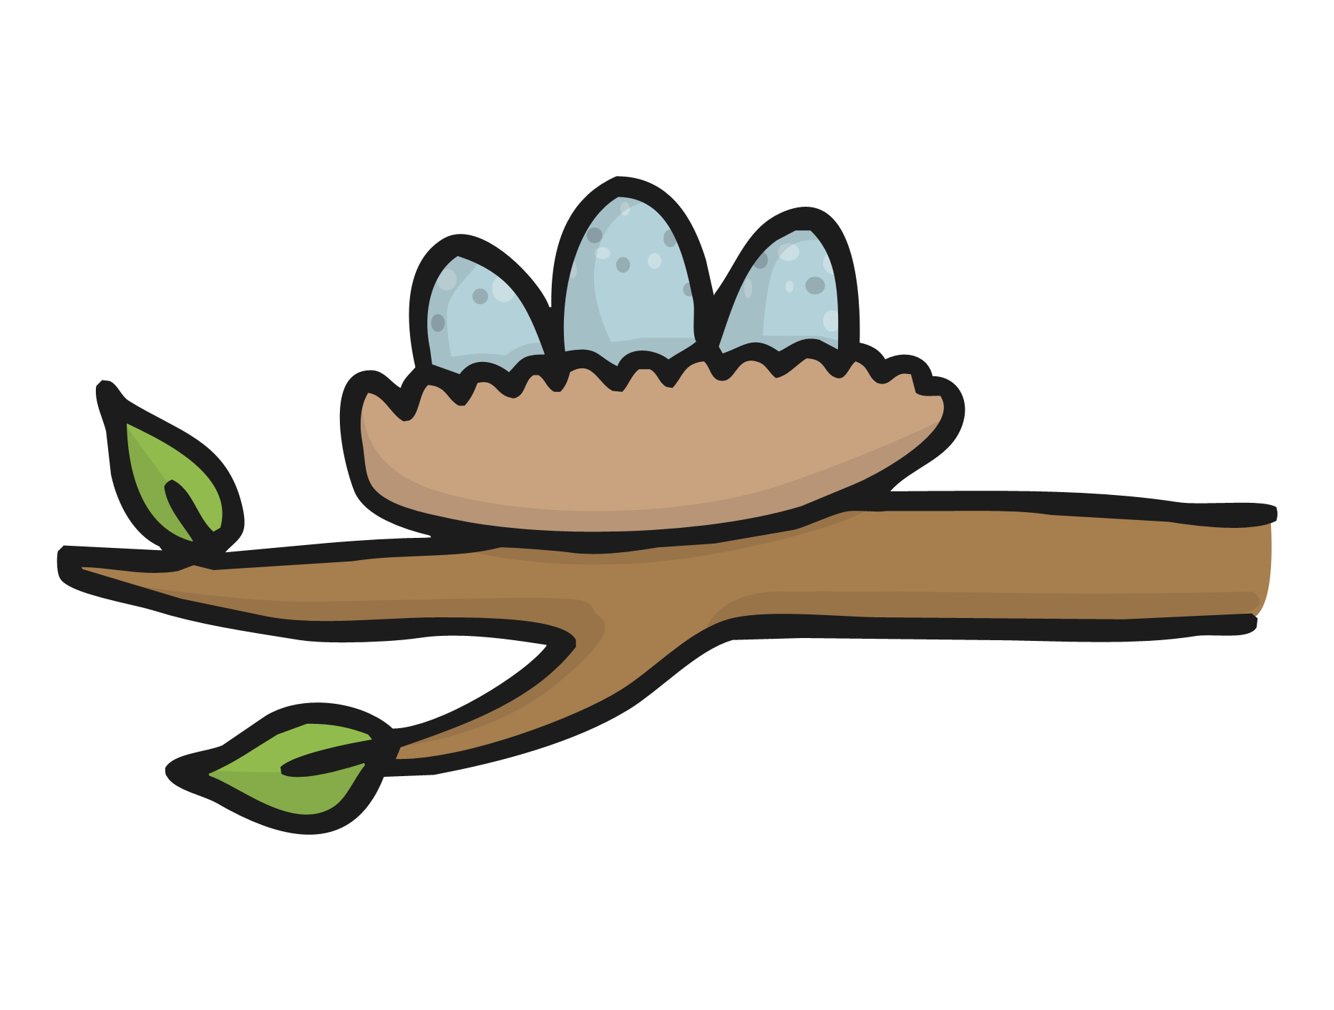
nest
next

Slide 4
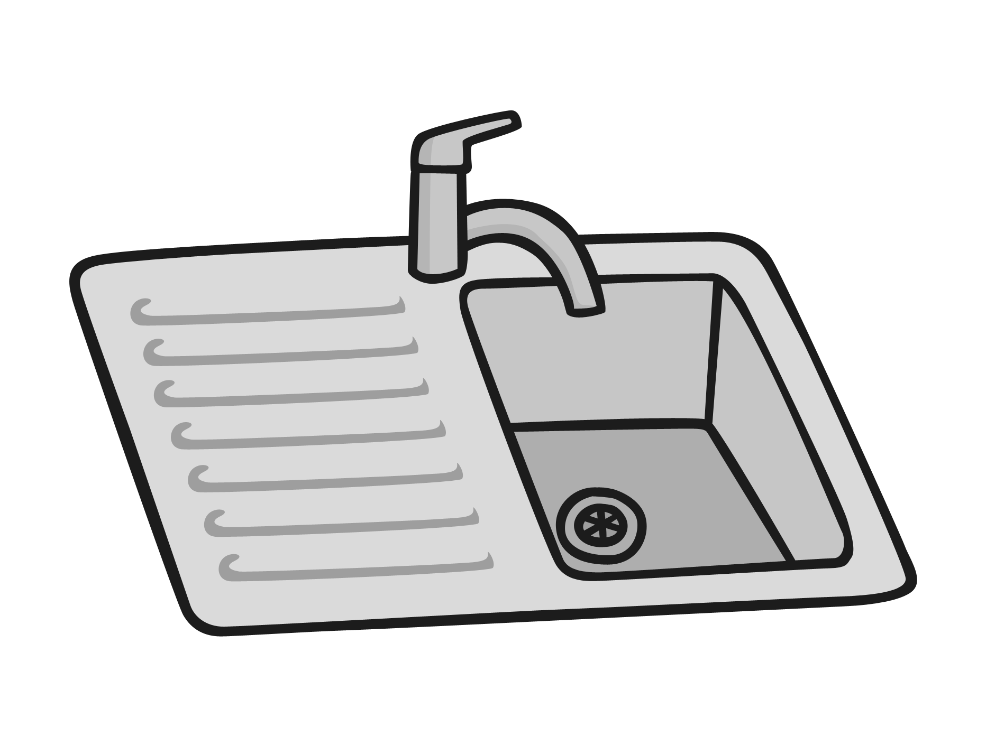
sink
next

Slide 5
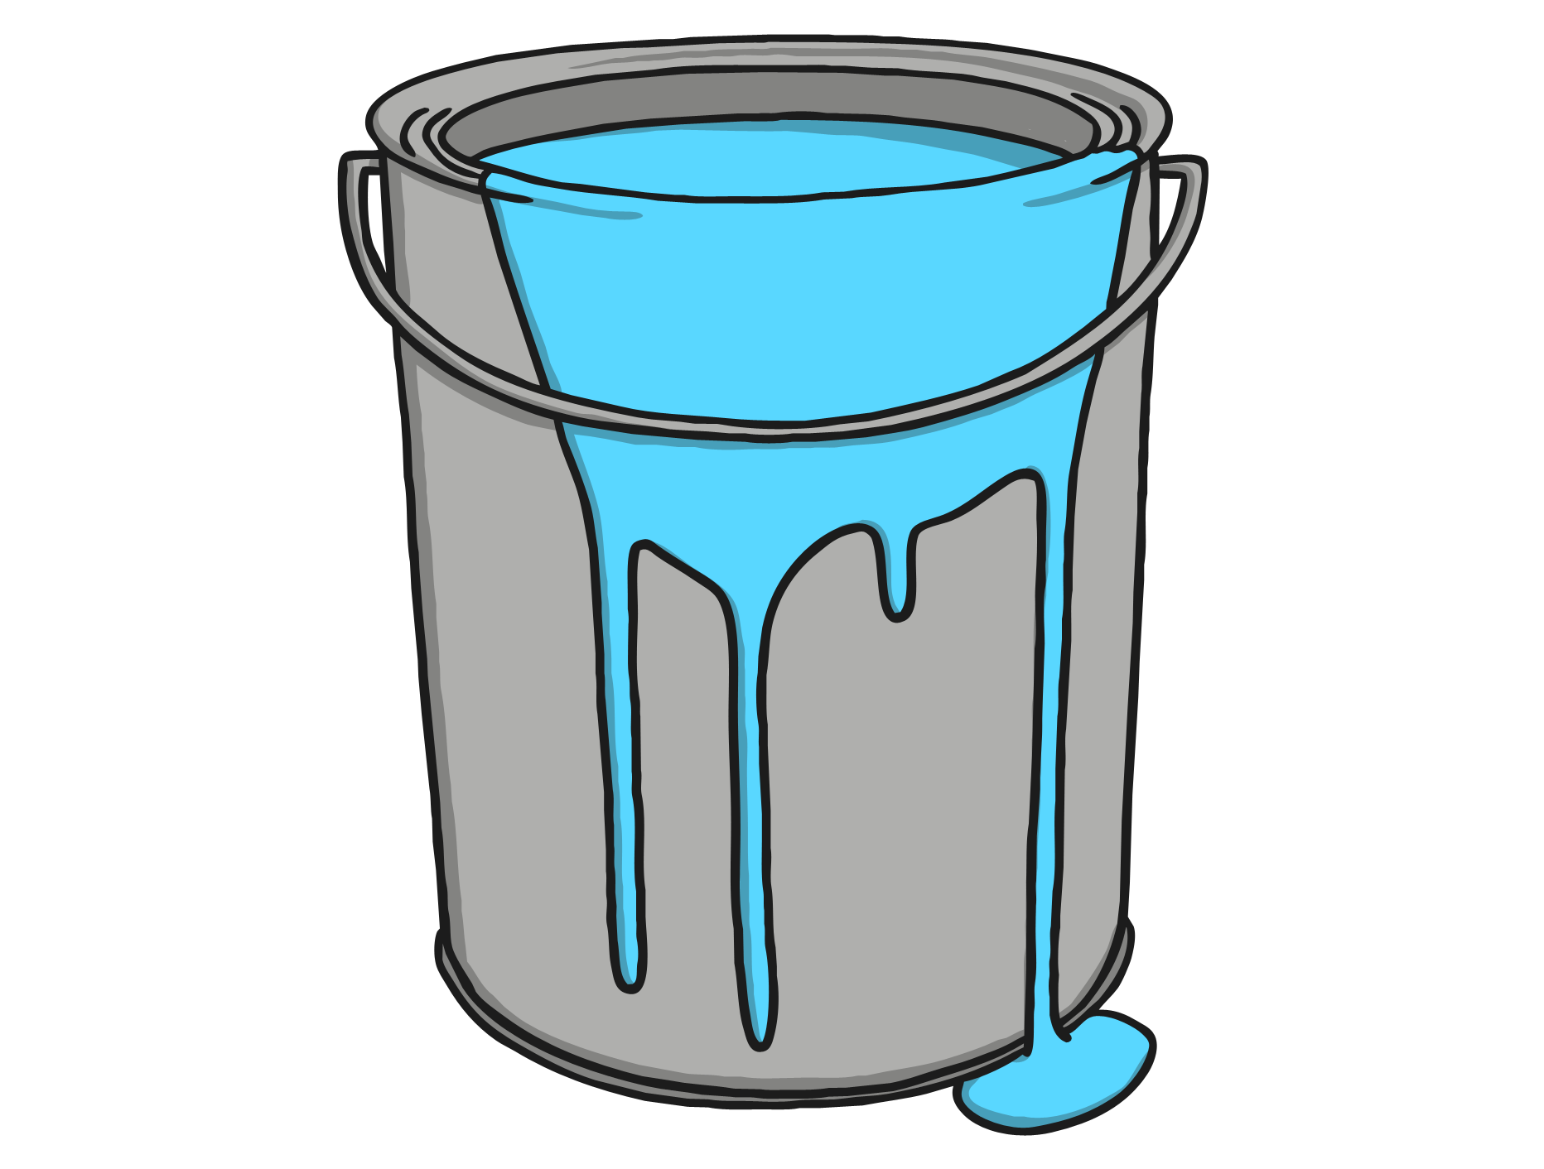
paint
next

Slide 6
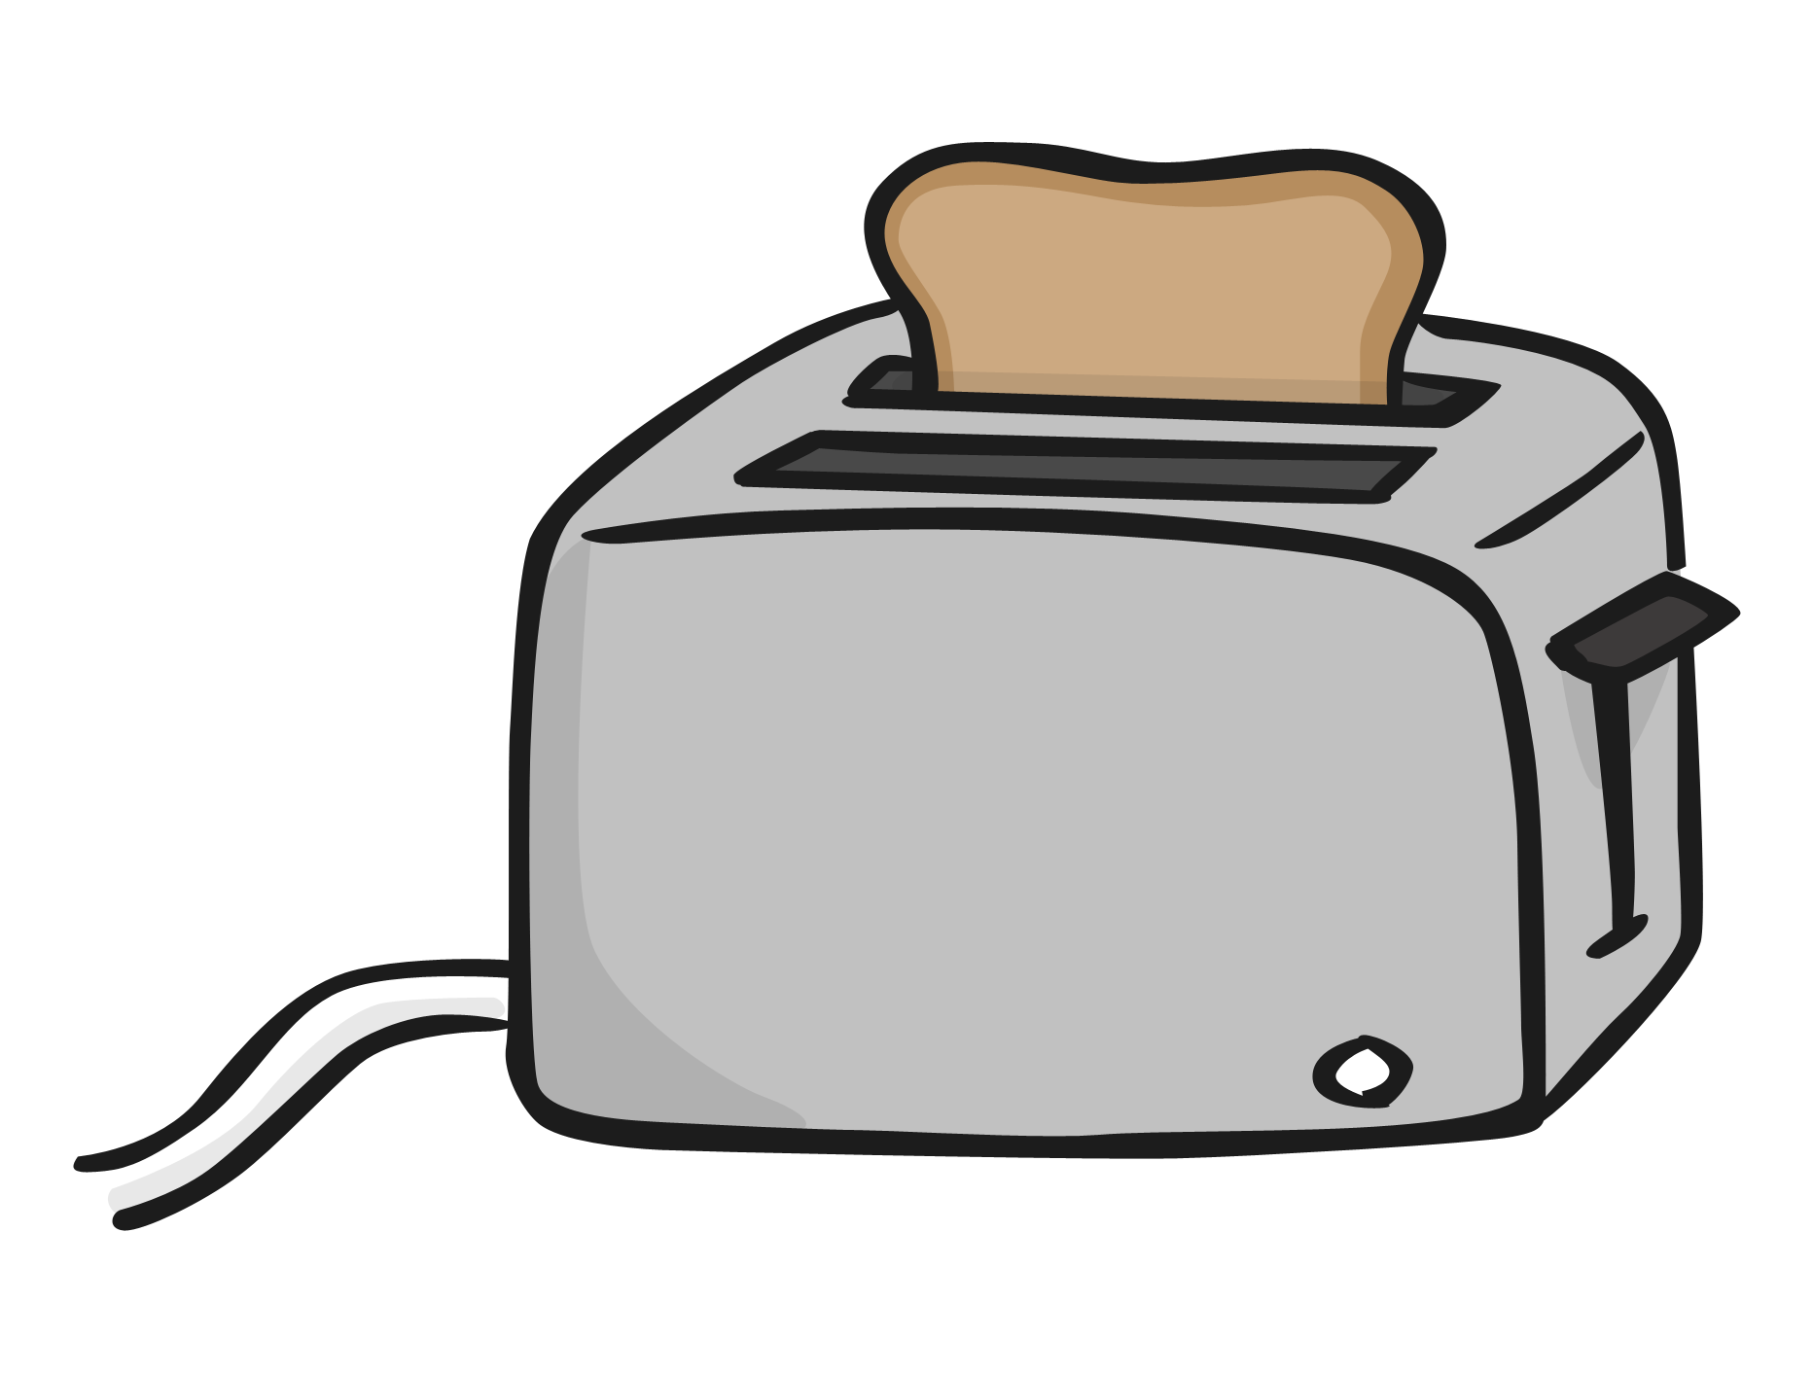
toaster
next

Slide 7
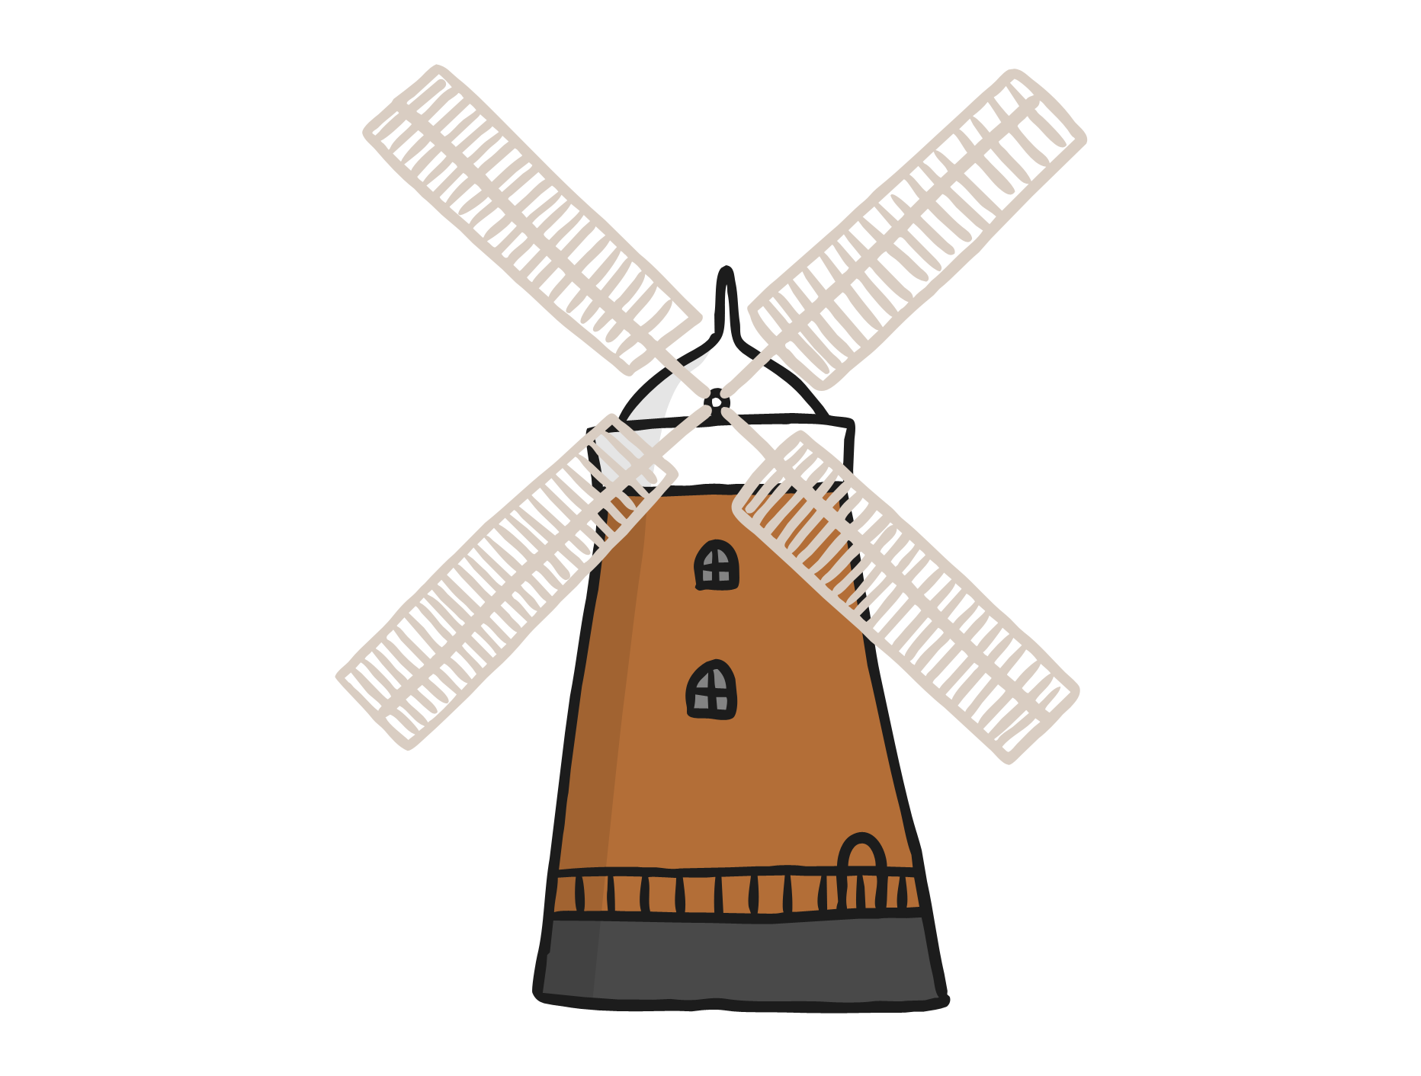
windmill
next

Slide 8
flag
next

Slide 9
Read the alien word
ralt
Write a sentence about a flag.

