Slide 1
Tuesday
How to Play Get Ready to Draw!
When you see a word, sound it out quietly to yourself.
Blend the sound to read what the word is.
When you know what the word is, draw a picture quickly on your board.
Turn your board around as soon as you can so that your teacher can see what you think the word says.
It is very important that you draw and show your answer quietly.
If you shout out the answer, somebody else might hear you and put it on their board even quicker than you can!
Home
Start!

Slide 2
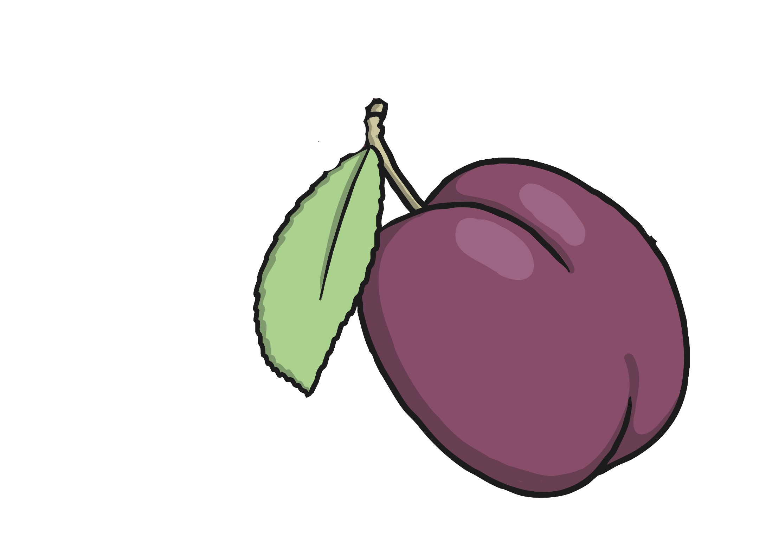
plum
next

Slide 3
gran
next

Slide 4
clown
next

Slide 5
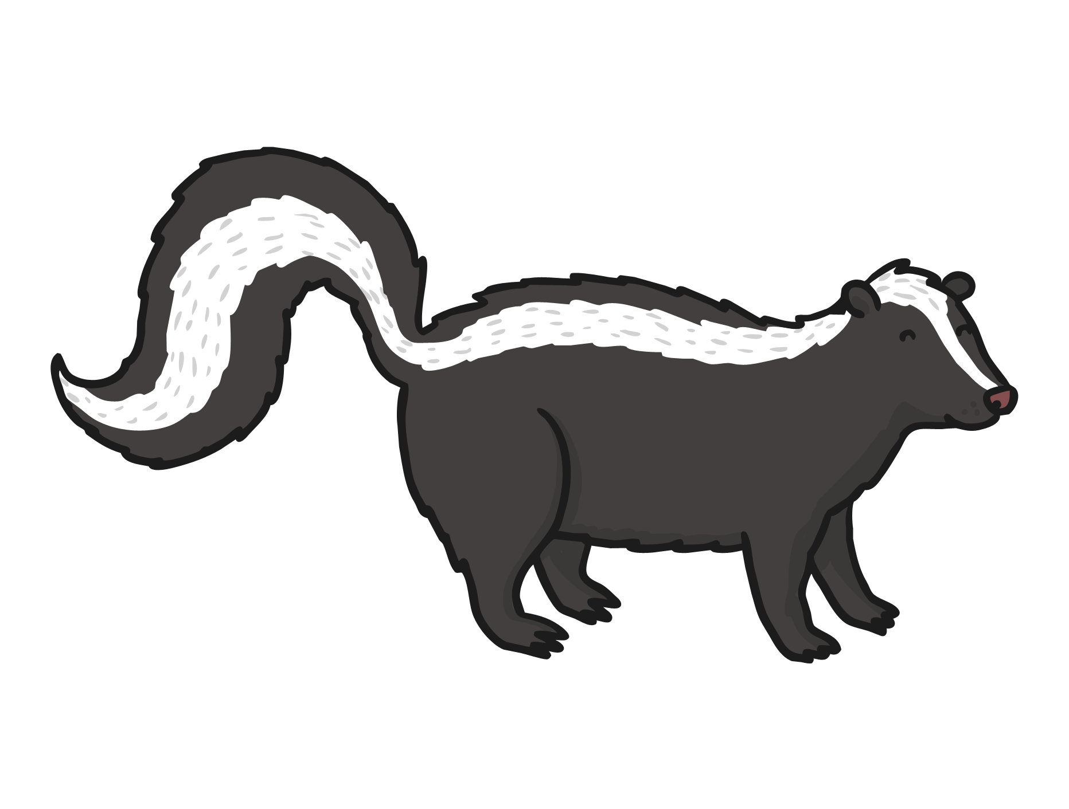
skunk
next

Slide 6
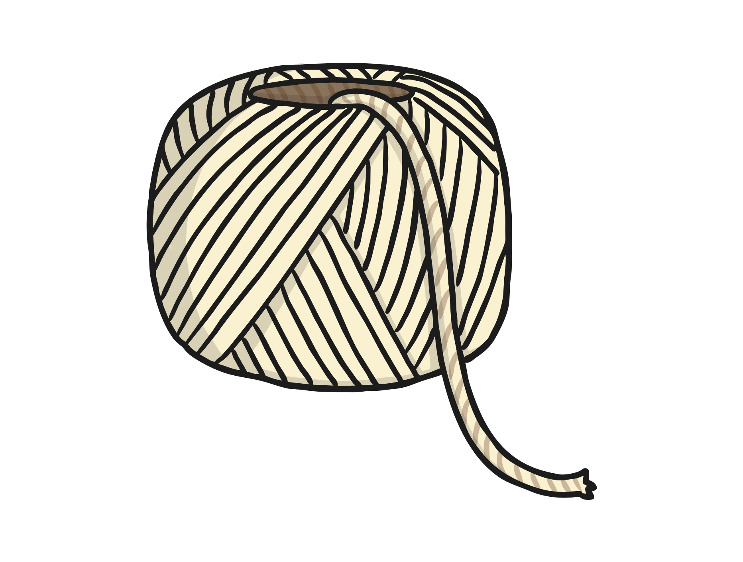
string
next

Slide 7
scarf
next

Slide 8
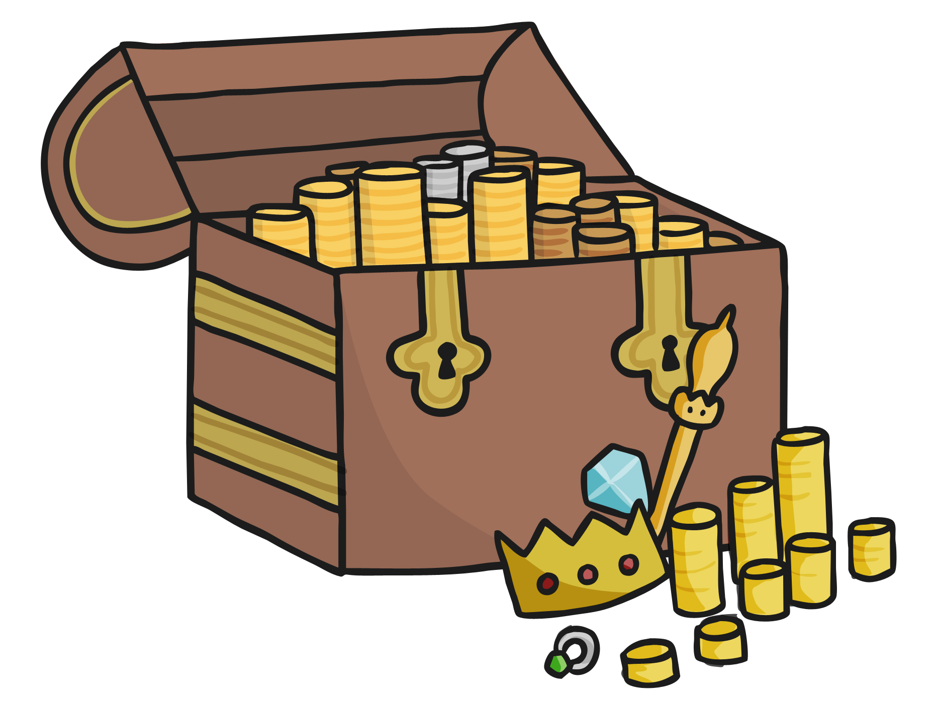
chest
next

Slide 9
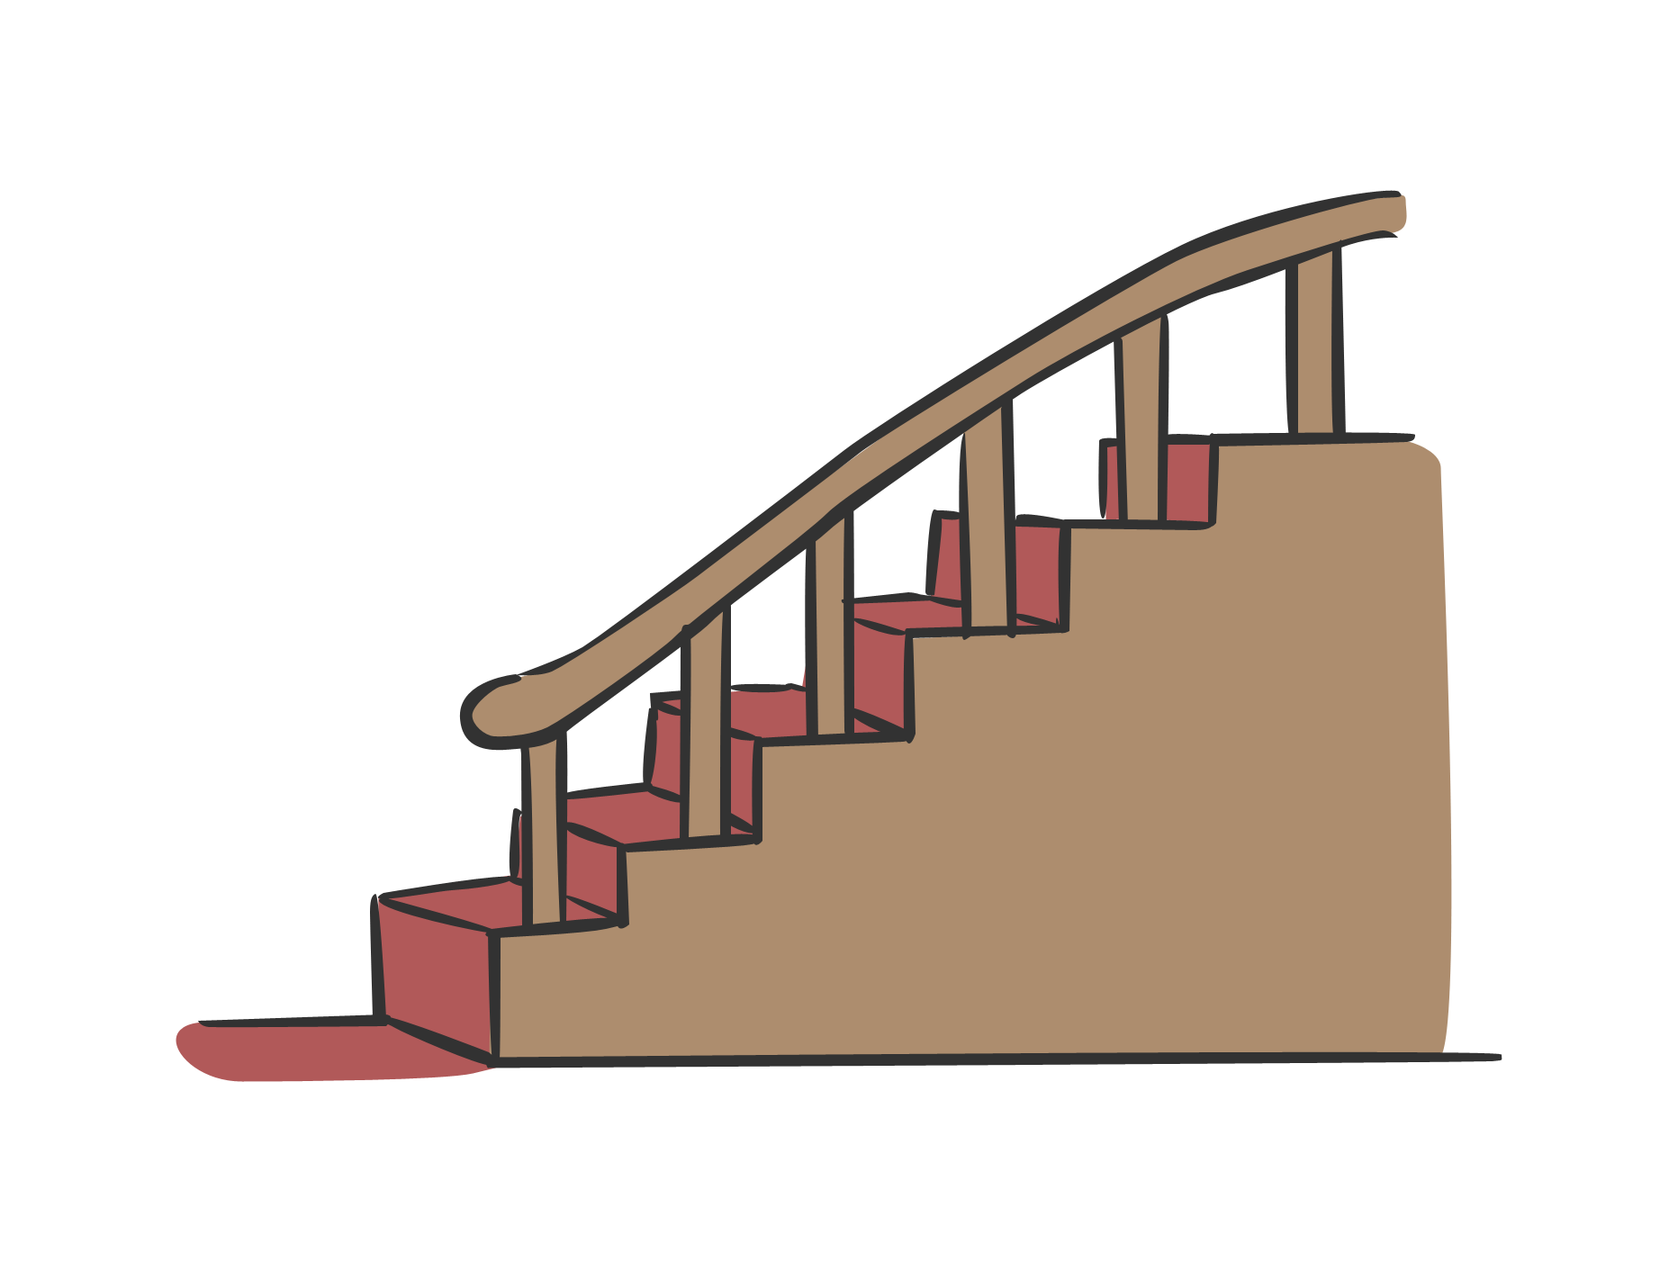
stairs
next

Slide 10
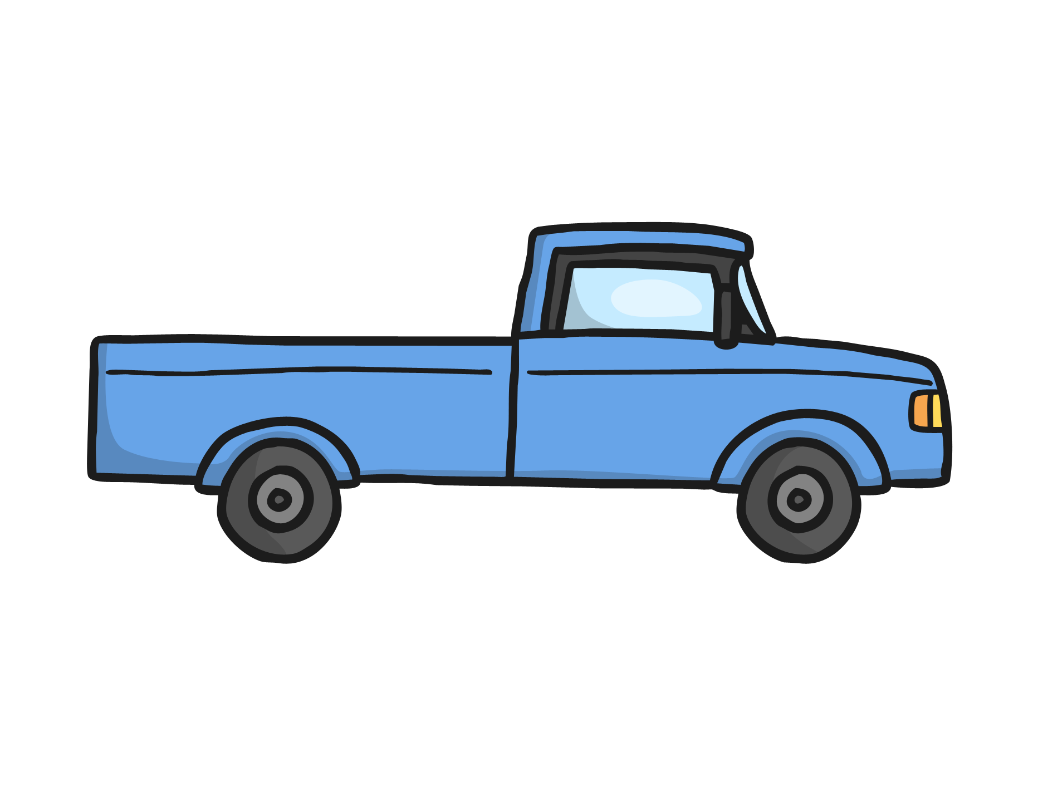
truck
next

Slide 11
Read the alien word
plim
Write a sentence about a truck.

