Slide 1
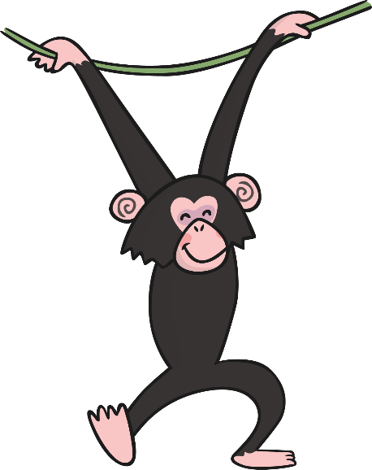
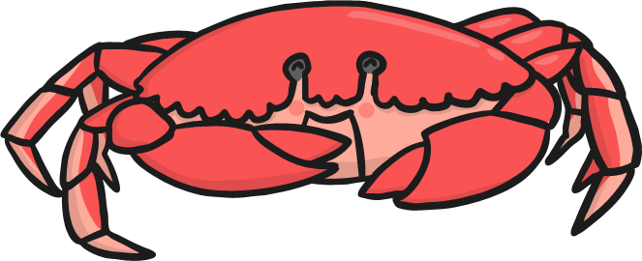
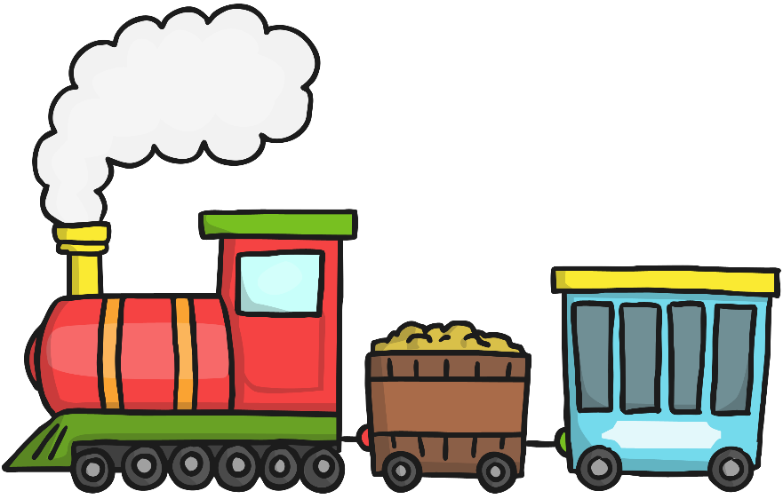
Thursday
Phase 4
Yes or No Questions

Slide 2
Flashcard/ Sound Recap

Slide 3
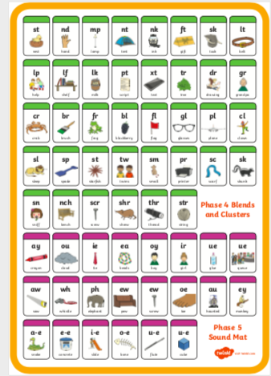
Flashcard/ Sound Recap (your child may not know any of phase 5 yet)

Slide 4
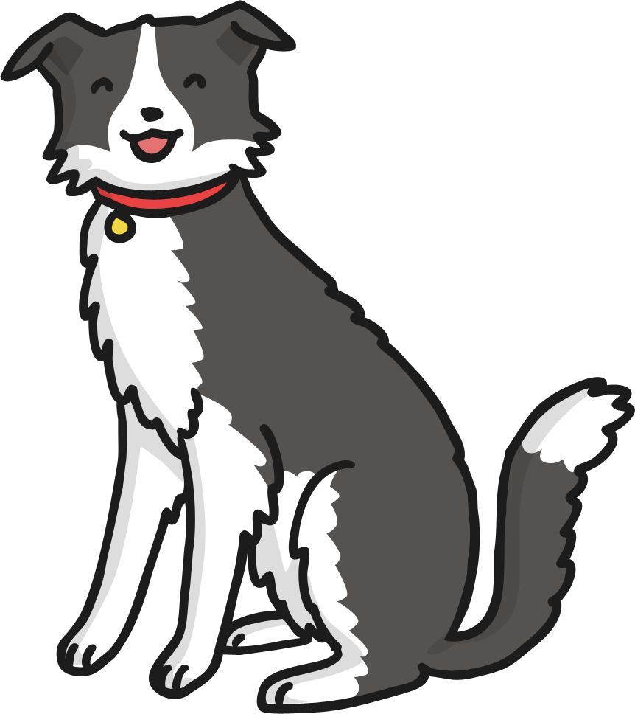

Slide 5
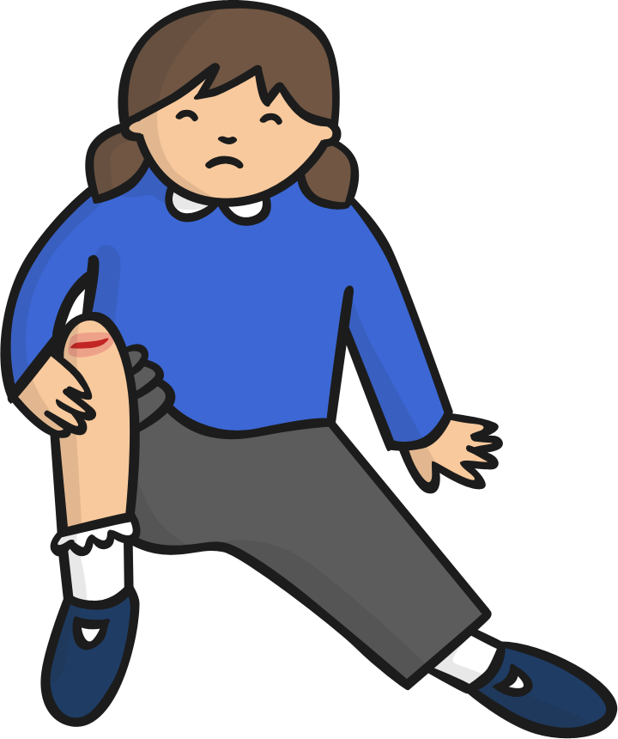

Slide 7
Read this alien word
cighm

Slide 8
Write these words (without looking at them!)
Black
Pain
Night
Can you join the ‘special friends’ letters together?

