Slide 1
Phase 4 Words and Pictures Game

Slide 2
Monday
How to Play Get Ready to Draw!
When you see a word, sound it out quietly to yourself.
Blend the sound to read what the word is.
When you know what the word is, draw a picture quickly on your board.
Turn your board around as soon as you can so that your teacher can see what you think the word says.
It is very important that you draw and show your answer quietly.
If you shout out the answer, somebody else might hear you and put it on their board even quicker than you can!
Home
Start!

Slide 3
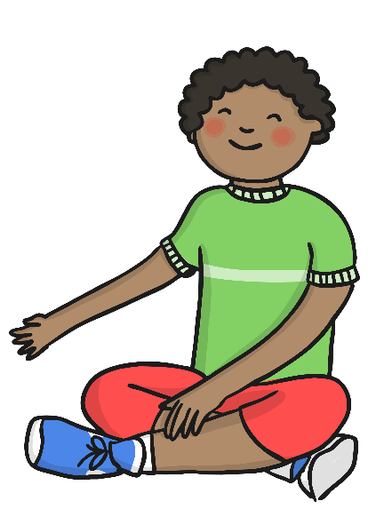
For these games, everybody needs their own whiteboard/paper and pen.
Click the game to play.
Get Ready to Draw!

Slide 4
tent
next

Slide 5
lamp
next

Slide 6
hand
next

Slide 7
bench
next

Slide 8
shelf
next

Slide 9
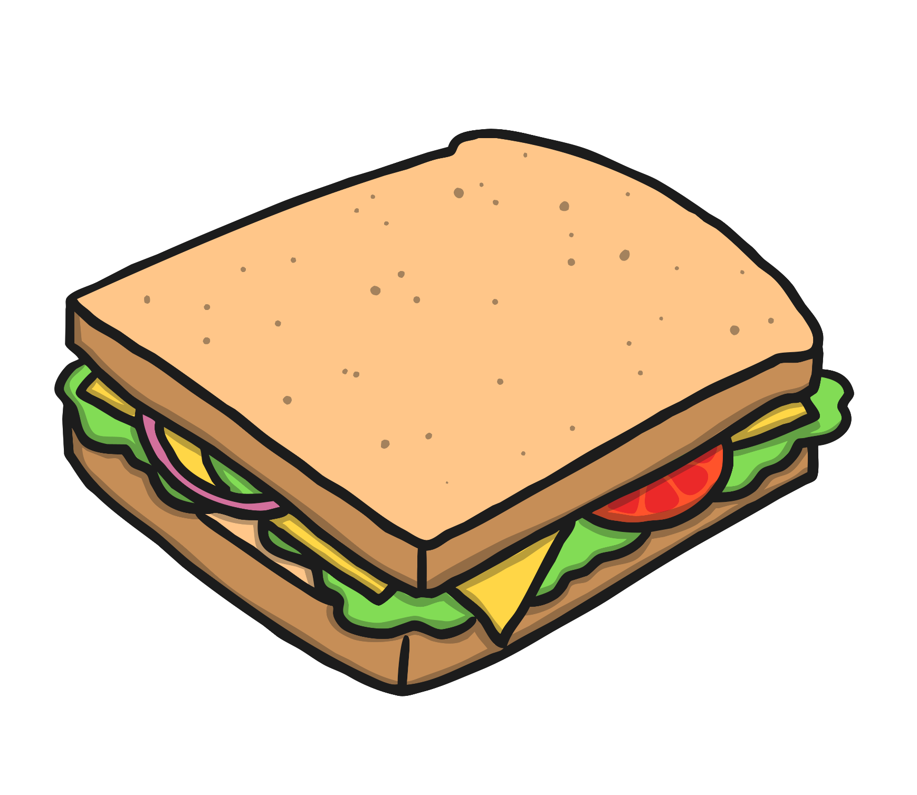
sandwich
next

Slide 10
lunchbox
next

Slide 11
frog
next

Slide 12
Read the alien word
gont
Write a sentence about a frog.

