Slide 1
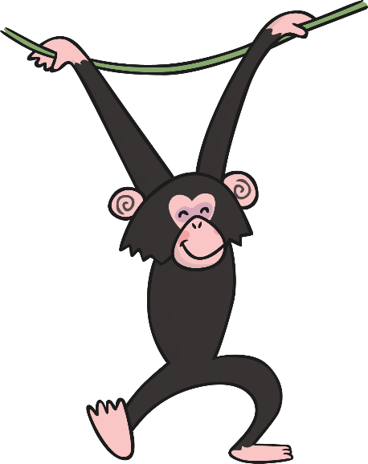
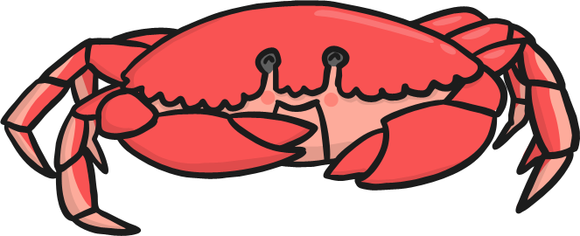
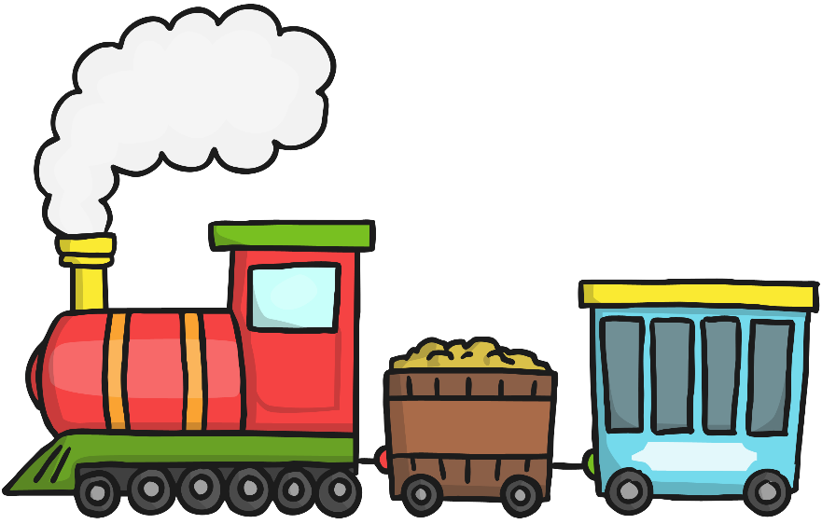
Friday
Phase 4
Missing Sounds

Slide 2
Flashcard/ Sound Recap

Slide 3
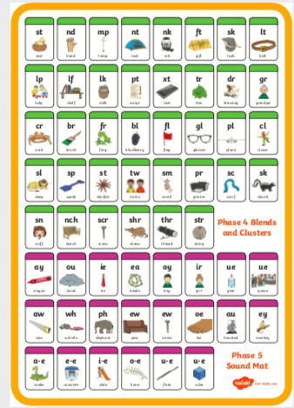
Flashcard/ Sound Recap (your child may not know any of phase 5 yet)

Slide 4
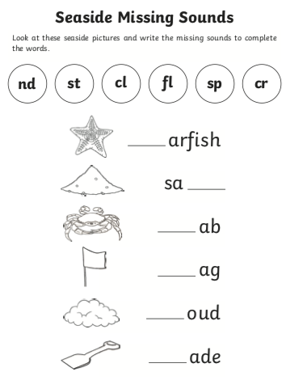

Slide 5
Read this alien word
crelt

