Slide 1
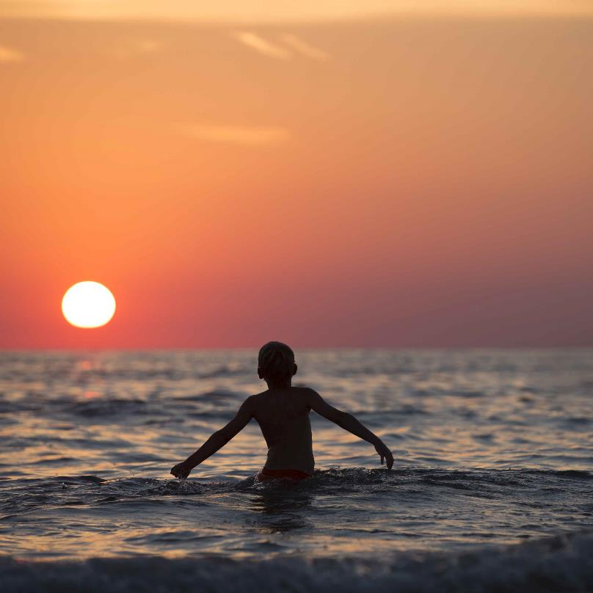
Oceans for beginners
X-Curric | Ages 5-7
Lesson 2
Our ocean and us

Slide 2
Lesson 2: Our ocean and us
Understand how we rely on the oceans
Give examples of what we get from the ocean
Use knowledge and understanding to plan a group project
Justify and explain choices

Slide 3
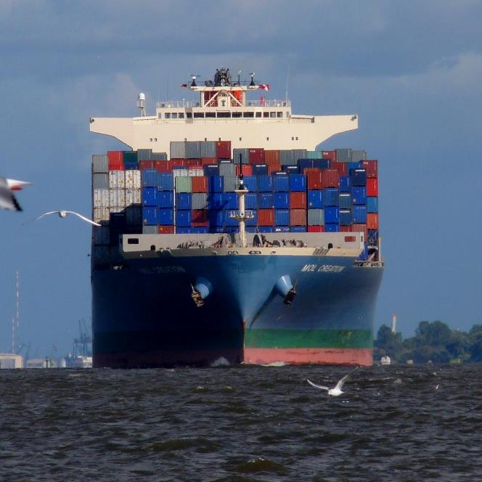
Lesson 2: Our ocean and us
What does the sea do for us?

Slide 4
Lesson 2: Our ocean and us
How does the sea help us?

Slide 5
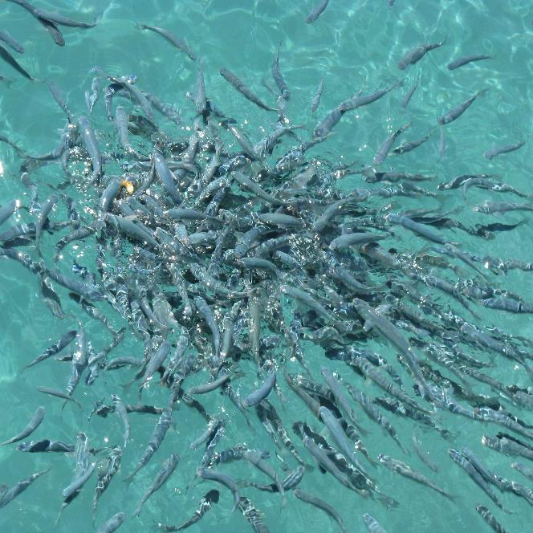
Lesson 2: Our ocean and us
Quiz

Slide 6
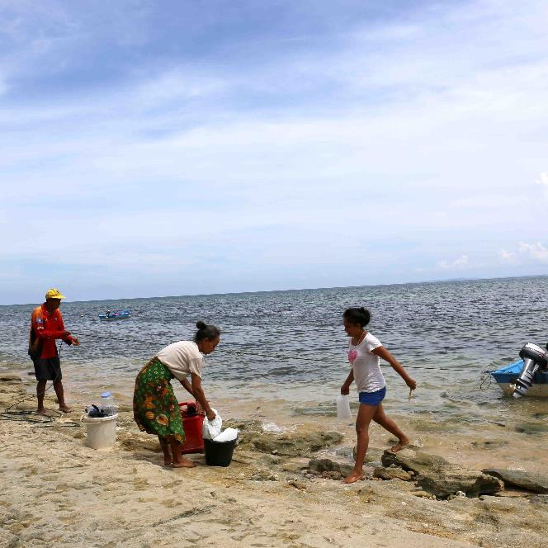
Lesson 2: Our ocean and us
Statement 1 The ocean gives people jobs.
True
False

Slide 7
Lesson 2: Our ocean and us
Statement 1 The ocean gives people jobs.
Lots of people work in and around the ocean, fishers, sailors, scientists and explorers.
True

Slide 8
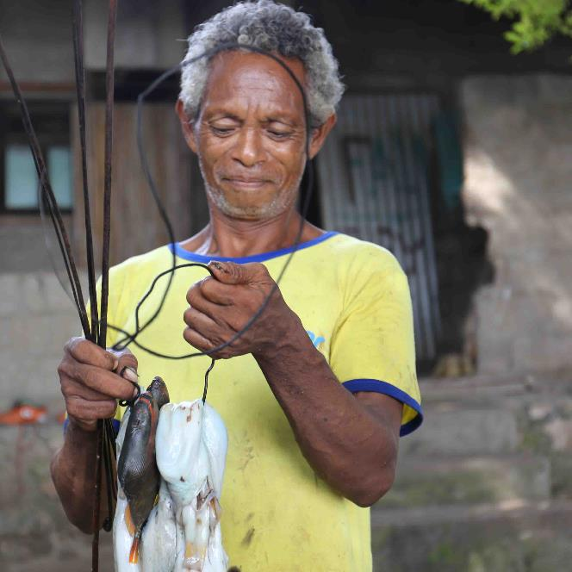
Lesson 2: Our ocean and us
Statement 2 The ocean gives us food.
True
False

Slide 9
Lesson 2: Our ocean and us
Statement 2 The ocean gives us food.
Billions of people depend on the ocean for their food. What types of sea-food have you tried?
True

Slide 10
Lesson 2: Our ocean and us
Statement 3 The ocean helps us transport things.
True
False

Slide 11
Lesson 2: Our ocean and us
Statement 3 The ocean helps us transport things.
Huge ships transport cargo all over the world, from food to toys, materials and cars!
True

Slide 12
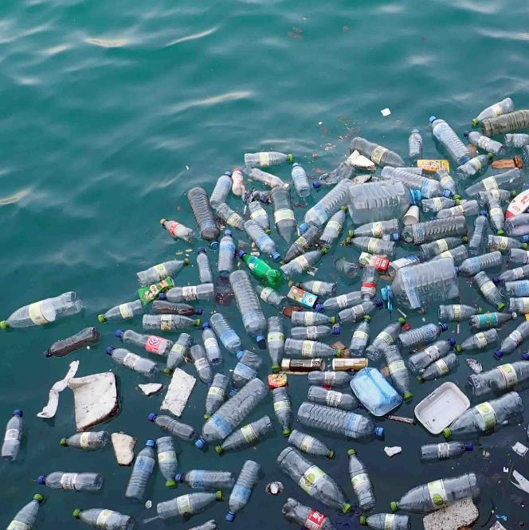
Lesson 2: Our ocean and us
Statement 4 Our ocean is in danger from plastic pollution.
True
False

Slide 13
Lesson 2: Our ocean and us
Statement 4 Our ocean is in danger from plastic pollution.
Lots of plastic gets into the ocean but it doesn’t belong there, it’s very harmful to marine life.
True

Slide 14
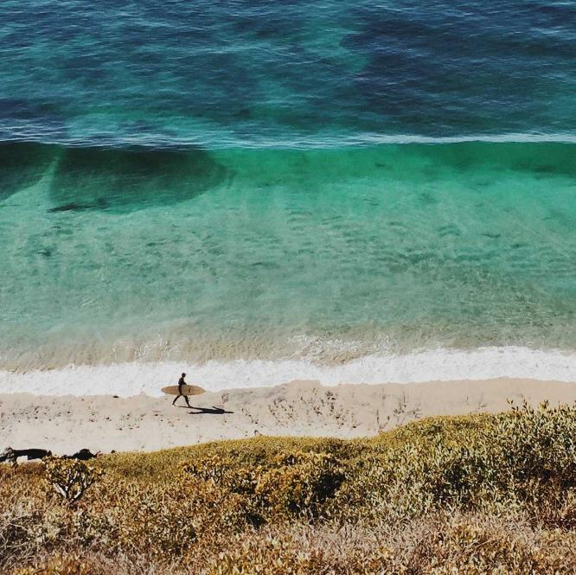
Lesson 2: Our ocean and us
Statement 5 People like to spend their free time or holidays in or around the ocean.
True
False

Slide 15
Lesson 2: Our ocean and us
Statement 5 People like to spend their free time or holidays in or around the ocean.
Swimming, snorkeling, boat trips, lying on the beach. Have you been on a holiday by the ocean?
True

Slide 16
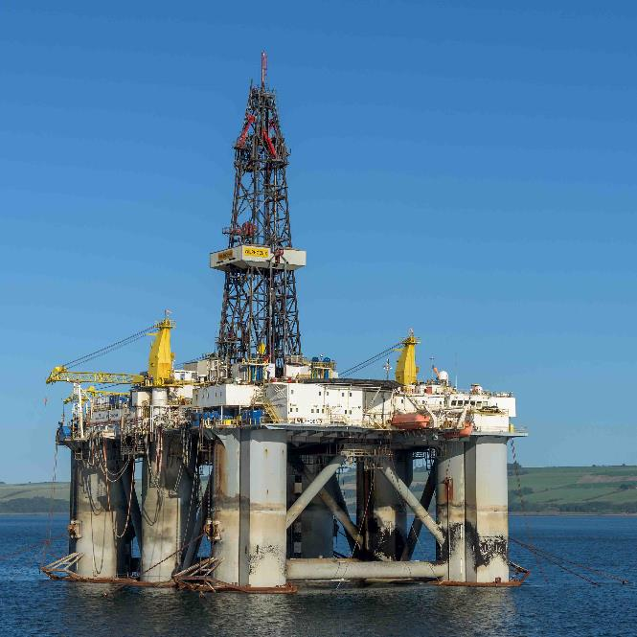
Lesson 2: Our ocean and us
Statement 6 We get energy from the ocean that powers our homes, schools and cars.
True
False

Slide 17
Lesson 2: Our ocean and us
Statement 6 We get energy from the ocean that powers our homes, schools and cars.
We use oil rigs to drill down under the ocean for oil and gas. We use the oil and gas for electricity and petrol.
True

Slide 18
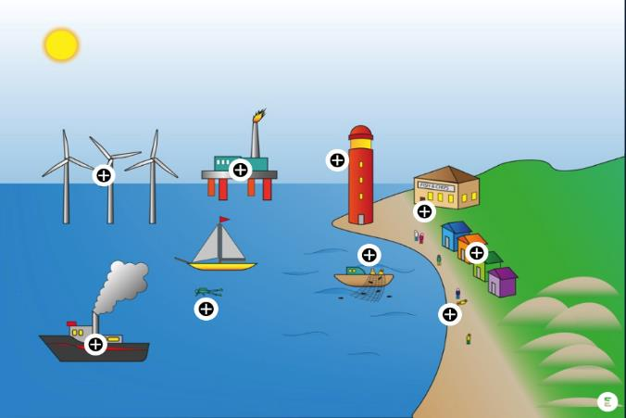
Lesson 2: Our ocean and us
Using our seas
VIEW GALLERY

Slide 19
Lesson 2: Our ocean and us
Making a diorama

Slide 20
Lesson 2: Our ocean and us
Review: Learning outcomes
Understand how we rely on the oceans
Give examples of what we get from the ocean
Use knowledge and understanding to plan a group project
Justify and explain choices

Slide 21
Lesson 2: Our ocean and us
Home learning
Keep a trash diary for the next week, record any items you throw away, what the material was and whether it was possible to recycle it.

Slide 22
Lesson 2: Our ocean and us
Slide | Title | Attribution
1 | Sunset | Pexels via Pixabay
3,10,11 | Shipping container | Heju via Pixabay
4 | City port | Free-Photos via Pixabay
5 | Feeding fish | Hardrockstar via Pixabay
12,13 | Bottles in the sea | Monica Volpin via Pixabay
14,15, 19 | Surfer | Jeremy Gallman via Unsplash
16,17 | Oil rig | Mustang Joe via Pixabay

