Slide 1
Ocean spreadsheet
Can you create your own spreadsheet to show the different living things that you would find in the ocean?

Slide 2
Ocean spreadsheet
On the slides you will find some guides and tips on how you can create your spreadsheet.
First you need to decide what the purpose of your spreadsheet is and the different categories you will use.
- Animal sizes
- Animal habitats
- Animal diets
You will need to do some internet research to gather
the information that you need for your spreadsheet.

Slide 3
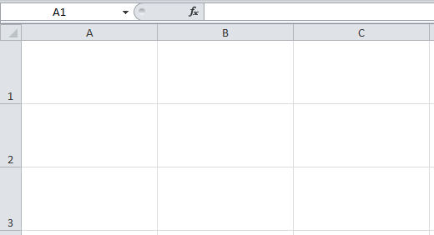
Introducing Spreadsheets
What do you know about spreadsheets already?
Does anyone know what they are used for?
What can they do?
Discuss with a partner and be ready to feed back any ideas.

Slide 4
Cell References
Everything in a spreadsheet goes into a cell (like a box in a grid).
Each cell is named by the row and column in which it is located.
See the Cells and Data Spreadsheet as an example.

Slide 5
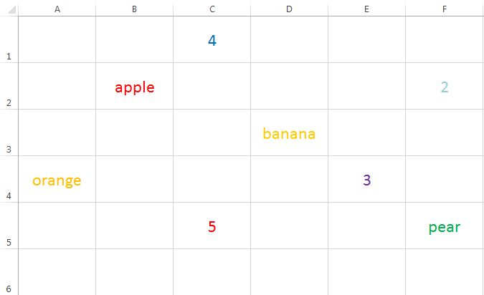
Cell References

Slide 6
Formatting Cells
Cells can be formatted to look clearer or more interesting, similar to word processing or desk top publishing.
Watch then practise how to change cell colours and borders, font size, style, colour and alignment, row height, column width.
You can also select an entire row, column or the entire sheet and then adjust or format multiple rows or columns at the same time.
Explore the formatting features so you can present your work attractively, if you have time after each future activity.

Slide 7
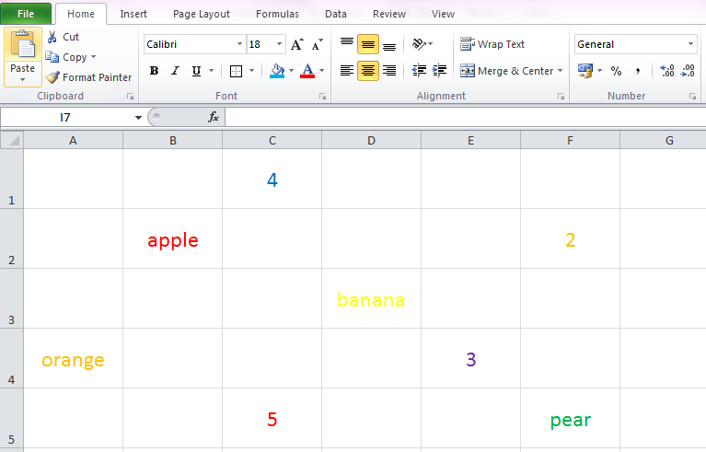
Formatting Cells
Font Style
Borders
Font Size
Cell Colour
Font Colour
Click and drag between rows or columns to adjust height or width.
Click on a row or column heading to highlight entire row or column.
Note: The exact look may change in different versions of the software.

Slide 8
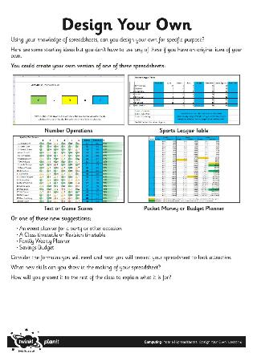
Create Your Spreadsheet
When you are ready to begin, you may like to jot down some notes first on paper or a whiteboard to decide what your spreadsheet will be for.
Next, open a new blank spreadsheet and start creating.
Consider the text labels, numbers and formulas required.
Make sure you think about your layout and present your design attractively (format font, colour, alignment, background, borders)

Slide 9
Creating Graphs
When you have completed your data, it can be presented as a graph.
Click Insert, then choose Column Chart/Graph.
Highlight the table from teams to points, including all rows.
The Move Chart button on the Chart Design toolbar can then be used to position the chart as a New Sheet.

Slide 10
Can you create a graph from your spreadsheet?
Can you show a graph for ocean animal features?
Can you show a graph for how many bioluminescence animals live in the ocean?
Can you show a graph for different sizes of ocean animals?
- How many ocean animals are < or > than given number?

