Slide 1
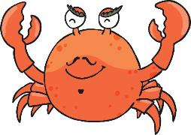
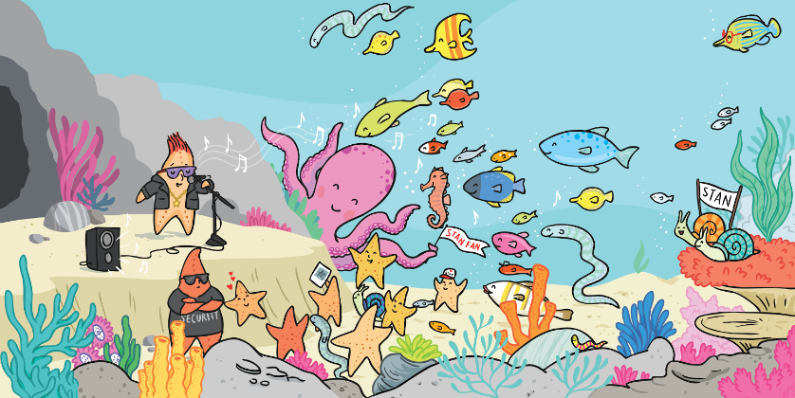
Creatures living in a Coral Reef
Click on a creature to find out more about it.

Slide 2
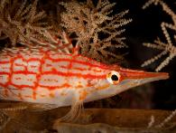
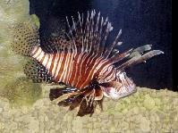
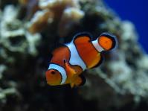
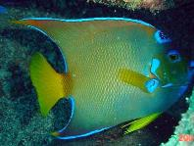
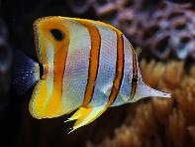
Fish
There are many different types of bright and colourful fish that live in coral reefs.
They are bright because they can easily camouflage themselves against the colours of the coral.
hawk fish
lion fish
clown fish
angel fish
butterfly fish
back
Photo courtesy of noelweathers, Bill Grolz, M.P.N.Texan, MPBecker, q.phia (@flickr.com) - granted under creative commons licence - attribution

Slide 3
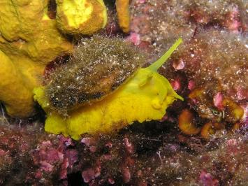
Sea Snails
Sea snails can be found in nearly every ocean. They are often found in coral reefs where there is lots of food for them to eat.
Sea snails breathe through gills, like a fish. They stick themselves to surfaces in the ocean, such as rocks and plants. They might also bury themselves in the sand.
Some sea snails sleep during the day and are active at the night (they are nocturnal).
back

Slide 4
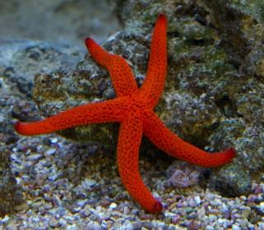
Starfish
Starfish cannot swim. They have hundreds of tiny feet on each of their arms, called tube feet.
Starfish like to eat tiny fish, clams, oysters, and snails. This means they are carnivores.
Starfish have two stomachs and five arms. They do not have a brain or any blood.
Starfish have tiny eyes on the end of each arm but they cannot see very well.
back

