Slide 1
Life in a Coral Reef

Slide 2
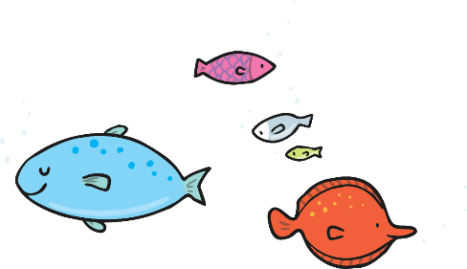
What Is a Coral Reef?
Corals are made up of tiny animals called polyps. These can be living or dead. They are very fragile.
The very first coral reefs formed about 500 million years ago!

Slide 3
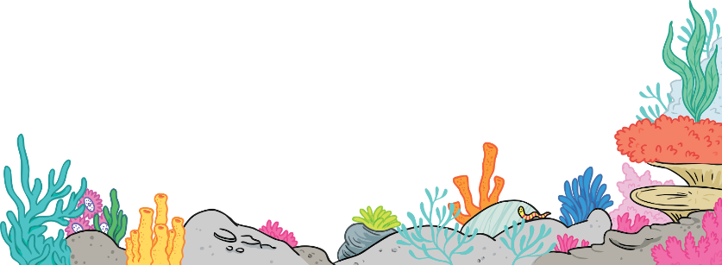
What Does a Coral Reef Look Like?
Most corals are brightly coloured.
They can be many colours, including yellow, red, pink, green, blue, orange and purple.
red
green
orange
blue
yellow
pink

Slide 4
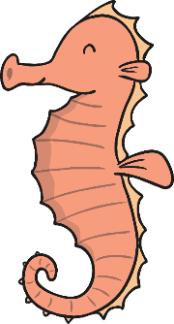
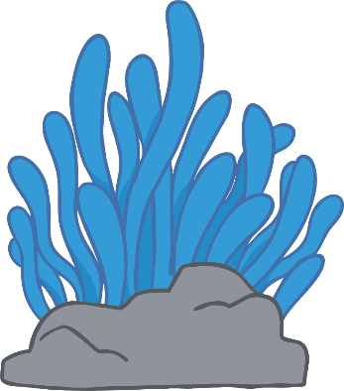
What Is a Coral Reef?
Coral reefs are mostly found in tropical oceans.
They are mostly found in shallow waters because they need sunlight to help them grow.

Slide 5
Coral Reef Fun Facts!
A group of corals is called a colony.
Coral reefs are home to millions of different types of creatures! These include fish, lobsters, clams, octopuses, seahorses and sea turtles.
Coral reefs feed at night-time. They have small stinging tentacles which they use to catch their prey.
The oldest living coral reef was over 4000 years old!
Corals are used in many different medicines.

Slide 6
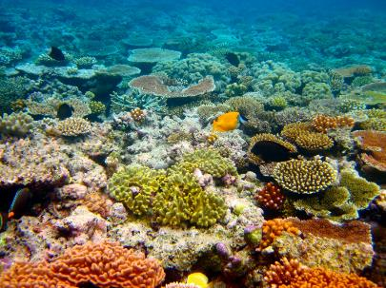
The Great Barrier Reef
The Great Barrier Reef is the largest coral reef in the world.
It is in the Coral Sea, off the coast of Queensland in Australia.
It is more than 1600 miles long and can be seen from space!
Photo courtesy of Taylor, Dream It. Do It. (@flickr.com) - granted under creative commons licence - attribution

Slide 7
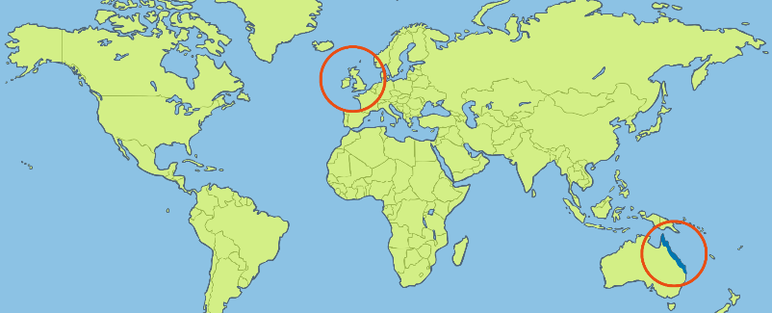
Where Is the Great Barrier Reef?
United Kingdom
The Great Barrier Reef

Slide 8
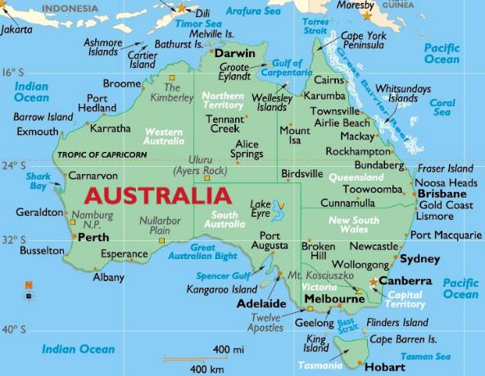
Where Is the Great Barrier Reef?
Australia
The Great Barrier Reef

Slide 9
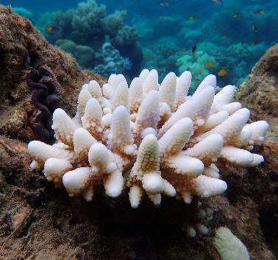
Threats to Coral Reefs
Large areas of the Great Barrier Reef are beginning to die.
Some of the coral is also losing its bright colour and turning white (this is called bleaching).
This is happening because the oceans are getting warmer.
Photo courtesy of oralCoE (@flickr.com) - granted under creative commons licence - attribution

