Slide 1
The Easter Story
By Lottie Hayes

Slide 2
Onwards to Jerusalem
Jesus was on his way to Jerusalem to celebrate Passover. Then he told his disciples to fetch him a donkey. He told them to say that he needed it. When he arrived the people covered the path with garments and palm leaves. They shouted things like Jesus is our king.

Slide 3
Betrayed By a Friend
Many people liked Jesus but the powerful men didn’t. They wanted Jesus dead, so Judas was told to betray Jesus for thirty pieces of silver.

Slide 4
The Last Super
Jesus knew that he had been betrayed, so he had a last super to say goodbye. At the table Jesus told his twelve disciples that one of them had betrayed him and that he would have to go to heaven with his father. Judas then stood up and left. Jesus gave them bread which he said was his body and red wine which he said was his blood. This is how they remembered him.

Slide 5
Praying for Life
Jesus and two of his disciples Peter and James went to Gethsemane. Jesus asked them to watch over him whilst he prayed. Judas arrived with soldiers he then kissed Jesus on the cheek, that was the sine that it was Jesus.

Slide 6
The trial for Jesus
The powerful men found it hard to prove Jesus guilty. Eventually they said that he dishonoured God for being his son.

Slide 7
Up The Hill With a Cross
Jesus was forced to carry his cross up the hill. The cross was hammered into the ground. Jesus put on a crown of thorns that made his head bleed. He was put in the middle of two robbers.

Slide 8
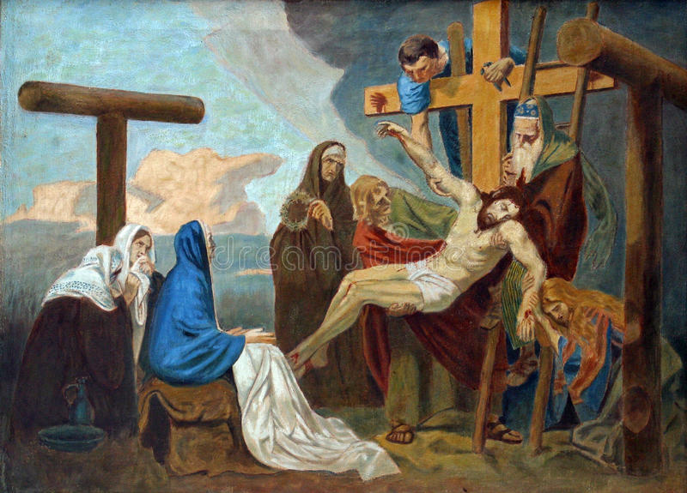
Down From The Cross
Jesus’s friends took him down from the cross. They put him in a tomb, then they covered it with a gigantic stone.

Slide 9
Alive Once More
Two days later Mary Magdalen went to see Jesus’s tomb but the great stone had been moved. Mary started to cry when she saw a man. She thought the man had taken Jesus, but this man was Jesus. She went and told everyone.

Slide 10
Back To Heaven
One day Jesus had to go back to heaven with his father, the disciples were very sad and didn’t want him to go. But Jesus had to go he said to pass on his teachings.

Slide 11
The End And Happy Easter ☺☺☺

