Slide 1
Mastery in Maths – What you
need to know
8th February 2019
Notes:
1

Slide 2
The myth of being ‘naturally good at maths’
The myth of ‘being naturally good at maths’ Many people think that some students can work to high levels and some cannot because of the brains they are born with, but this idea has been resoundingly disproved. Study after study has shown the incredible capacity of brains to grow and change within a remarkably short period of time.
Professor Jo Boaler, Stanford University
Notes:
At Ashton Vale we believe that all children deserve the opportunity to be able to develop a deep, long-term understanding of maths. Maths should be enjoyable and fun for all and nobody should believe they are not ‘good at maths’.
2

Slide 3
Maths Mastery At a Glance
Inclusive approach where all children achieve
‘We’re all on the same journey. Some people may take slightly different paths like into the swishy, swashy grass but we all come back together.’
Notes:
We decided to adopt a maths ‘mastery approach’. This means that every member of the class has the right to be on the same maths journey.
The whole class moves through content at broadly the same pace. There is no dividing children into ‘children who can and children who can’t’. Mastery offers the same curriculum to all building self-confidence. It can sometimes be explained by referring to the book ‘We’re Going on a Bear Hunt’ – In the story of the bear hunt…
All children set off on the same maths journey, moving in the same direction. Some children may take a slightly different path. They may need more time to grasp a concept. They may need physical concrete materials such as cubes to support them. But the majority of children should all come back together on the same path for the next part of the journey.
At any one point in a child’s journey through school, they have achieved ‘mastery’ if they have a solid enough understanding of the maths that has been taught so that they can move on to more advanced material. Maths isn’t a subject that anyone can ‘master’ in its entirety – we are all always learning!
3

Slide 4
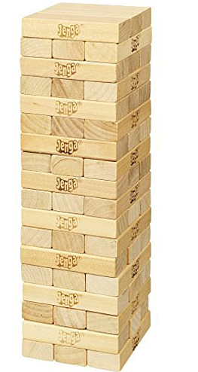
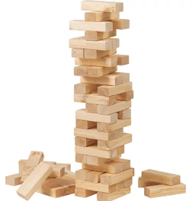
Maths Mastery At a Glance
Building a solid tower of understanding
Notes:
However all moving along the same path in maths doesn’t mean that children aren’t provided with a challenge. Obviously some children grasp new concepts quicker than others. These children will be pushed further to see problems in different ways and will be extended. We are aiming to build a solid tower of understanding rather than pushing a child on too quickly and the tower to become wobbly.
4

Slide 5
Maths Mastery At a Glance
Notes:
So, here is an example of maths mastery for a Year 1 child who has quickly grasped the concept of number patterns. They can quite easily spot and make a pattern such as 2, 4, 6, 8 but can they move these numbers around to make two different patterns using each number once?
5

Slide 6
Maths Mastery At a Glance
Notes:
They might fill in 10, 11, 12, 13, 14 for the first pattern. But then they cant use 10, 11 and 12 for the next pattern! Being able to persist with problems such as this within a topic rather than pushing a child onwards to the next topic is what provides children with outstanding reasoning and problem-solving skills later on.
6

Slide 7
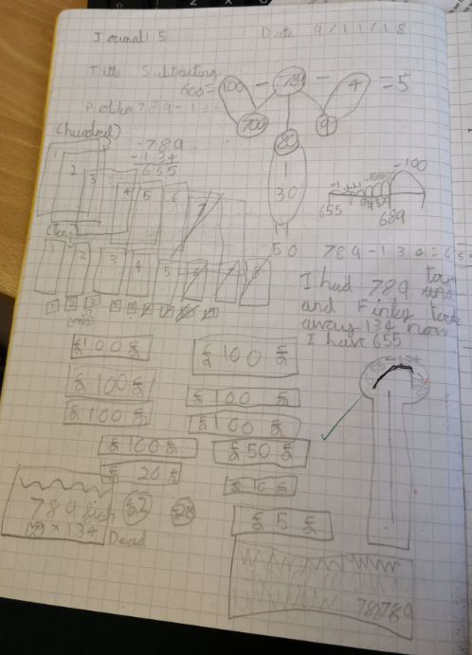
Maths Mastery At a Glance
Notes:
Mastery is not just about finding the answer but has a large focus on finding numerous methods to get there - therefore deepening their understanding of problem solving. Like you can see from one of the Year 3s maths journals he’s been pushed to find as many methods as possible to solve a problem and has also written his own explanations. Y6 children sit 2 reasoning SATS papers and being able to approach a question confidently will help them greatly.
7

Slide 8
UK adoption
The Department for Education and OFSTED have all emphasised the pedagogy and heuristics developed in Singapore. Today, maths textbooks based on the Singapore maths approach are being used in thousands of schools across the UK and have been widely adopted by the Department for Education’s Maths Hubs.
Notes:
Maths No Problem is based on Singapore Maths. It has been widely praised by The Department for Education and OFSTED and is being increasingly used in schools across the UK. It has proven to be a highly effective scheme and countries that have adopted this approach outperformed many western countries.
8

Slide 9
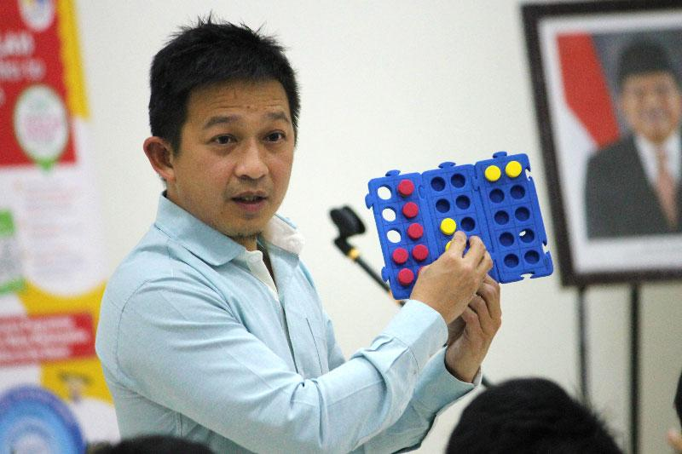
Dr Yeap Ban Har is one of the world’s leading experts in professional development for teachers of Singapore Maths. He is the consultant and author of the Maths No Problem scheme.
Notes:
Myself, Miss Mitchell and Mr Hollis were lucky enough to attend a 3 day training course with Dr Ban Har. He is one of the world’s leading experts in teaching Singapore Maths and is also the author of the Maths No Problem mastery scheme. It was an inspiring 3 days and has since enabled us to fully immerse Ashton Vale into achieving the vision of maths mastery in our school.
9

Slide 10
Features of an Ashton Vale Maths Lesson…
Vast majority of children work together on the same objective
Time given to children to explore their ideas
Children and staff always talk in full sentences with correct vocabulary
‘Marvellous mistakes’ are happily shared and unpicked
We use government recommended textbooks ‘Maths No Problem’
Each lesson has mastery elements that provides each child with sufficient challenge
Lastly, it is a fun, interactive and resourceful approach
Notes:
10

Slide 11
Each child has their own textbook and workbook. The textbook contains the lessons and the workbook is what the children fill in at the end of their lesson.
Notes:
Each child is given their own textbook and workbook. The textbook contains the lessons and the workbook has questions for the children to fill in.
11

Slide 12
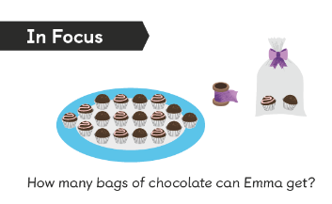
The focus task gives children the opportunity to talk about a problem and think about how they would solve it.
Notes:
KH: Every lesson starts with a problem. In the textbook this is called a ‘Focus Task’. Children are given time to talk about or investigate how they would solve the problem. This part is very often practical too with resources given to the children. Encourages mathematical language and methods used.
12

Slide 13
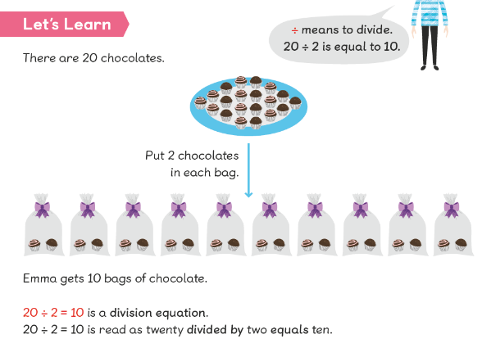
The children share with the teacher what they think and together they come up with different methods. This is also a teaching opportunity where they teacher will guide them in perhaps a new method.
Notes:
The next stage usually involves the children sharing with the teacher their different methods. This is also the main teaching part of the lesson where the teacher will guide the children perhaps with a new method or strategy. This is usually very practical and may involve several different examples. This is called the ‘Lets Learn’. The teacher may refer the children to their textbooks to show them, do it practically or show them on the Interactive White Board.
13

Slide 14
In Key Stage 1 and occasionally in Key Stage 2 an ‘Activity time’ will follow.
Notes:
In KS1, the children may either apply what they have learnt through an activity like the example above (some of which you might see later in the classrooms)
14

Slide 15
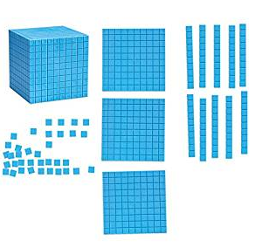
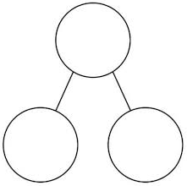
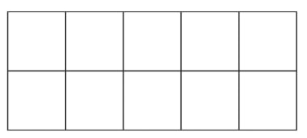
Dienes
Part-part whole model
Tens frame
Notes:
Maths No Problem gives children opportunities to explore different resources– it follows the belief that you should first work with physical objects to secure understanding before moving onto more abstract problems. These resources are carefully chosen to help children understand the structure of the maths. They are not just for the struggling children or the younger children.
The resources above are some of the models used.
15

Slide 16
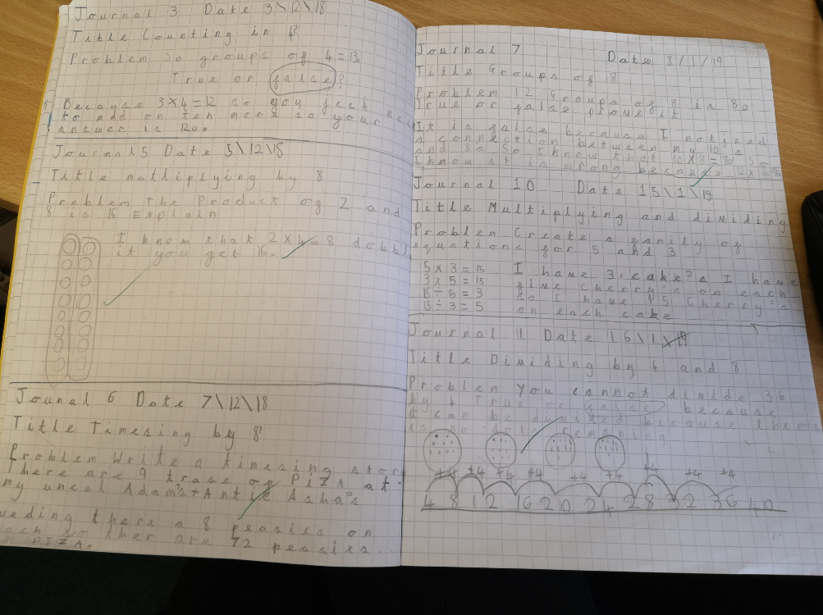
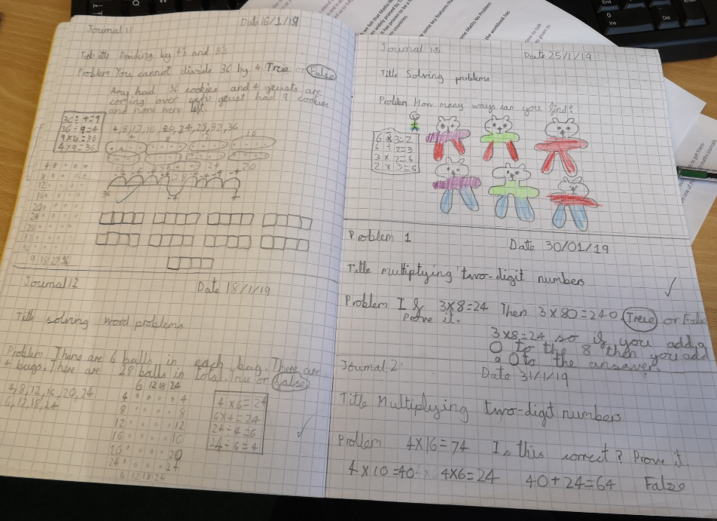
Having the opportunity to journal is important for children to explore what they have learnt and deepen understanding.
Notes:
In ks2 and occasionally in ks1. All children have a book with squared paper in which is their maths journal. In here, children have the freedom to tackle problems, use models and images, make mistakes to develop and deepen their mathematical understanding about a concept.
16

Slide 17
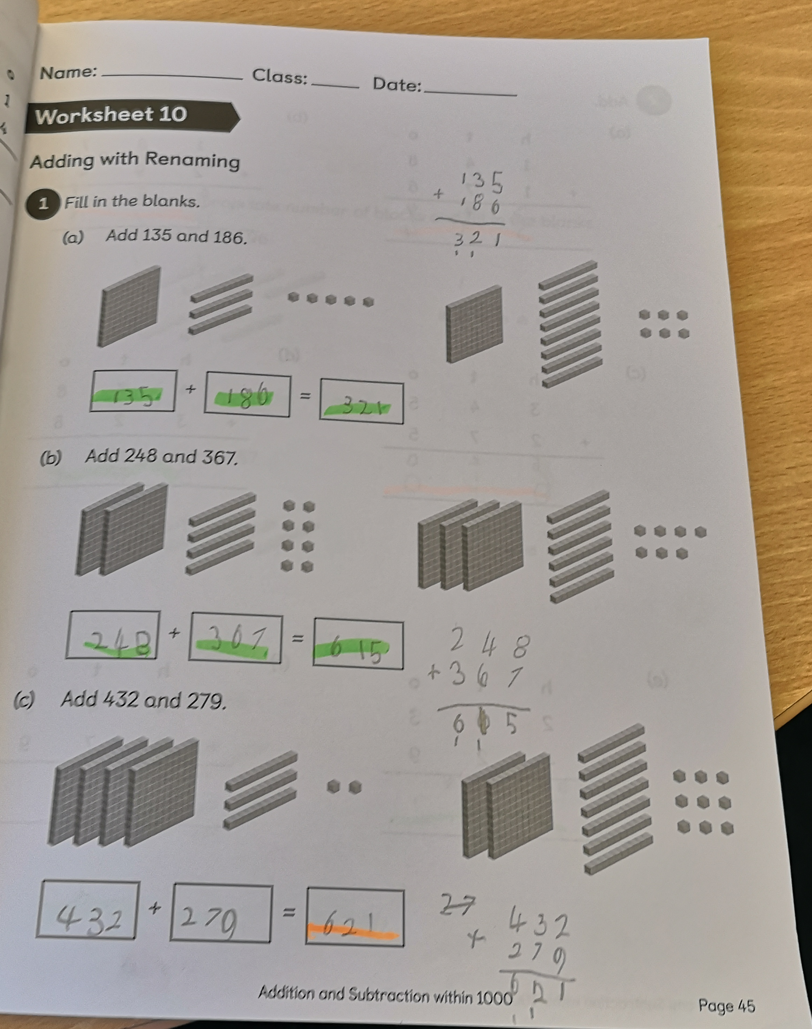
Finally children fill out their workbook pages.
Notes:
At the end of the lesson the children will spend between 10-20 minutes completing their workbooks. These sum up the work the children have done that day and indicates their overall understanding. Those who have a strong understanding will be extended by their class teacher to show greater depth not acceleration.
17

Slide 18
How can you help at home?
Talk positively about maths
Reinforce the message that everyone can achieve and
that struggle is essential
Watch Maths No Problem videos (on the Ashton Vale
website)
Ask children to explain their thinking - homework
Practice relevant number facts e.g. times tables,
number bonds
Talk to your child’s teacher if you have any concerns
Notes:
18

Slide 19
Thank you for coming today!
You now have the opportunity to go and see maths in action in the classroom.
If you have any questions please come speak to either one of us after.
Notes:
19

