Slide 1
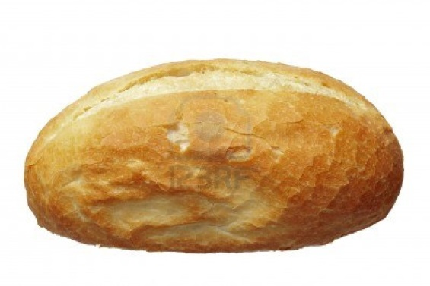
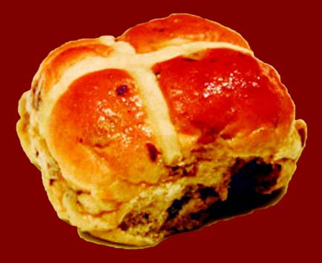
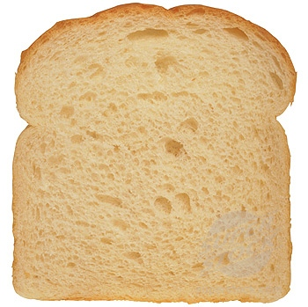
Welcome Bay Class.
What is the same?
What is different?

Slide 2
Let’s make hot cross buns!
First get into your groups.
2) Next take off any jumpers / cardigans / fleeces.
3) Then wash your hands.
Heat oven to 220C/fan 200C/gas 7.

Slide 3
Ingredients
500g strong white bread flour
½ tsp salt
2 heaped tsp mixed spice
50g caster sugar
50g butter , chopped into cubes
200g mixed dried fruits
7g sachet easy-blend dried yeast
200ml milk
2 eggs

Slide 4
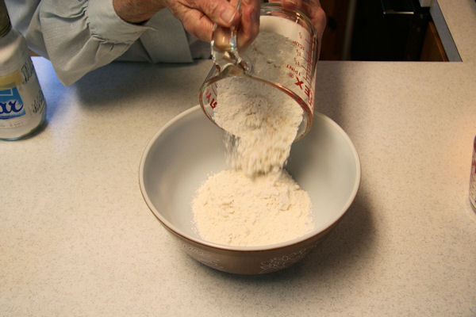
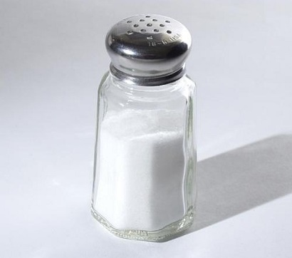
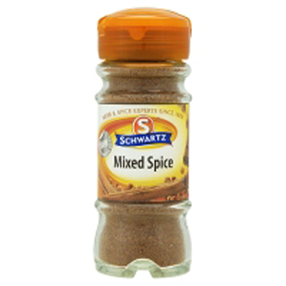
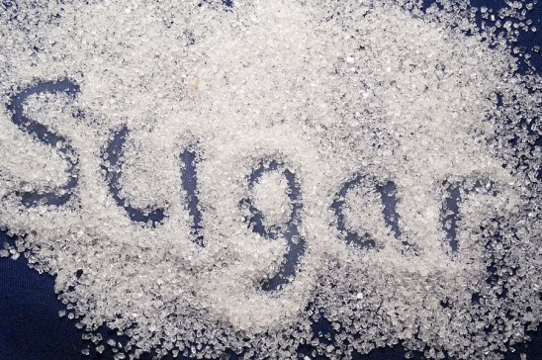
Here’s what to do…
1) First, tip the flour into a bowl and stir in the salt, mixed spice and sugar.

Slide 5
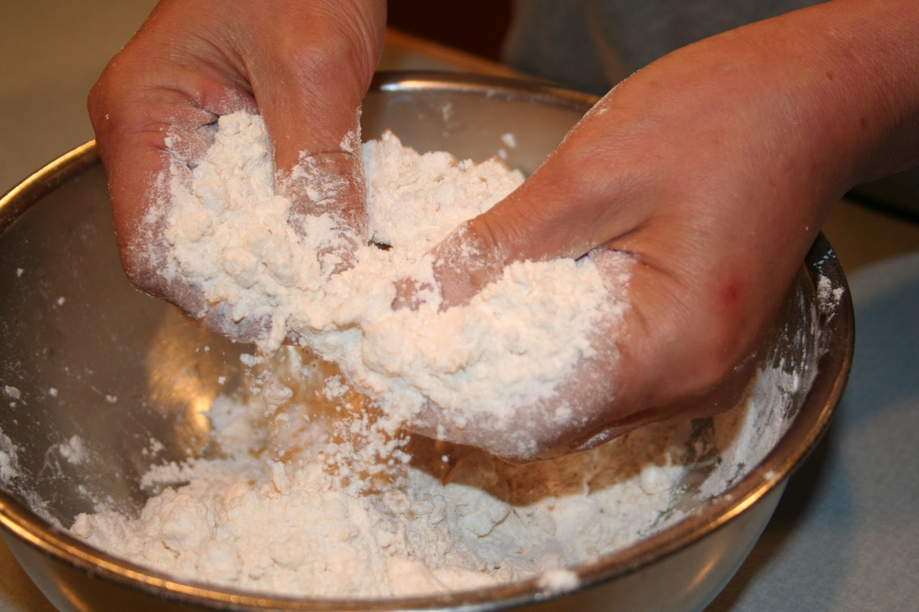
2) Next, rub in the butter with your fingertips.

Slide 6
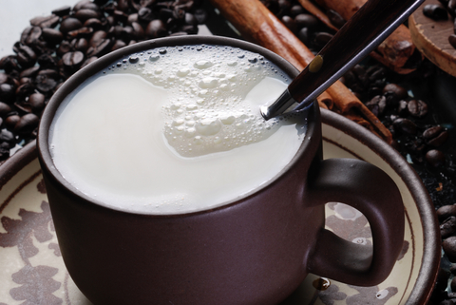
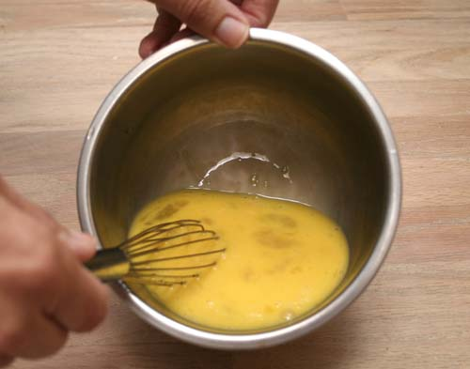
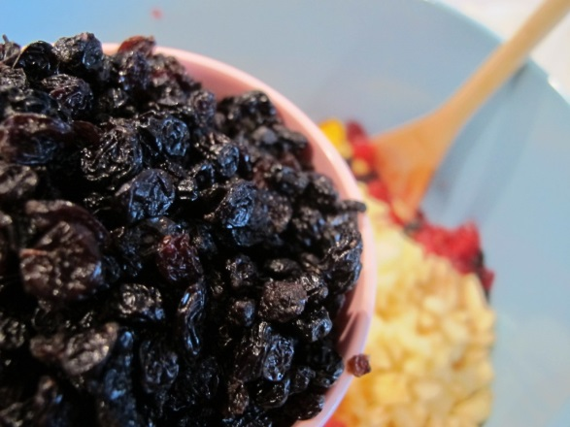
3)Then gently warm the milk so it is hot, but still cool enough to put your finger in for a couple of seconds.
4) After that beat with the eggs and yeast, then pour into the dried ingredients with the dried fruit.

Slide 7
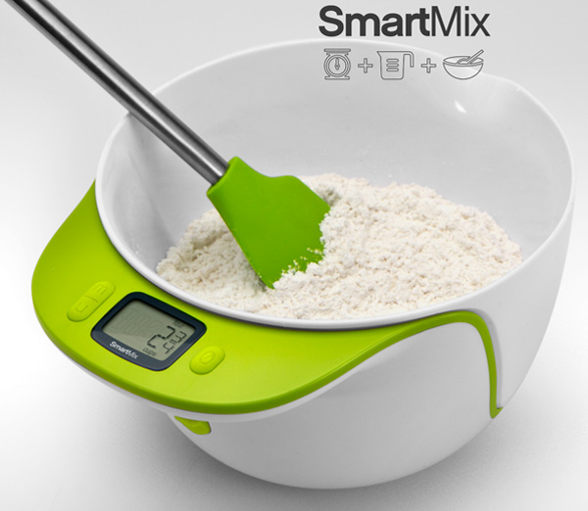
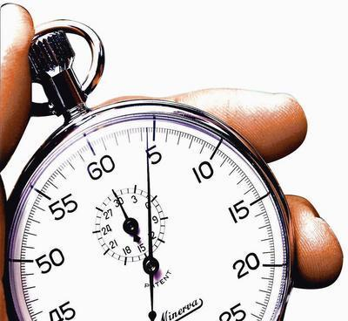
5) Next , using a blunt knife, mix the ingredients to a moist dough, then leave to soak for 5 mins.

Slide 8
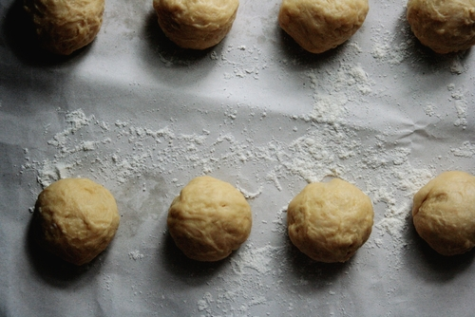
6) After that take out of the bowl and cut the dough into 8 equal pieces.

Slide 9
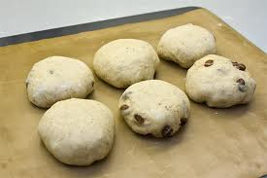
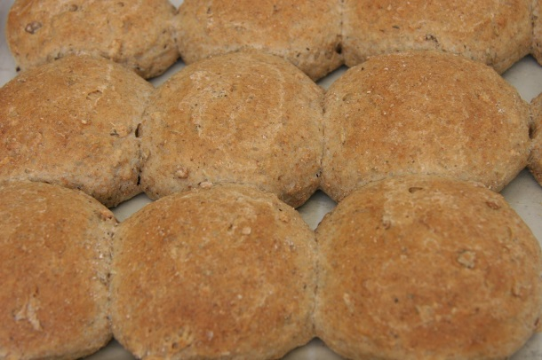
Then shape the dough into buns on a floured surface.
8) Space apart on a baking sheet, cover loosely with cling film, then leave in a warm place until half again in size. This will take 45 mins-1 hr 15 mins, depending on how warm the room is

Slide 10
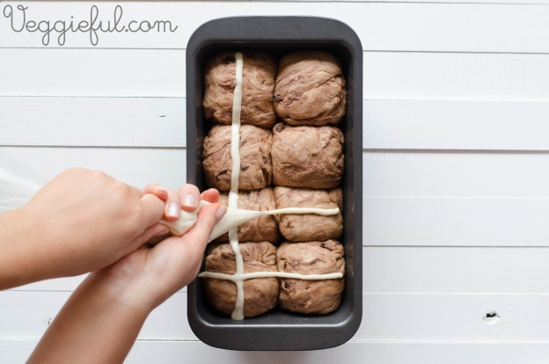
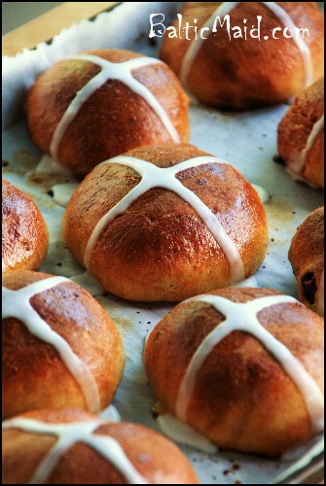
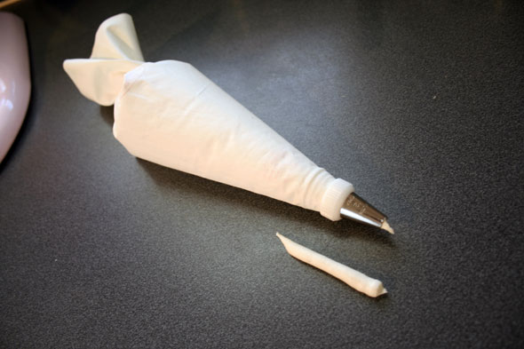
9) Then mix the flour with 2 tbsp water to make a paste. Pour into a plastic food bag and make a nick in one of the corners. Pipe crosses on top of each bun.

Slide 11
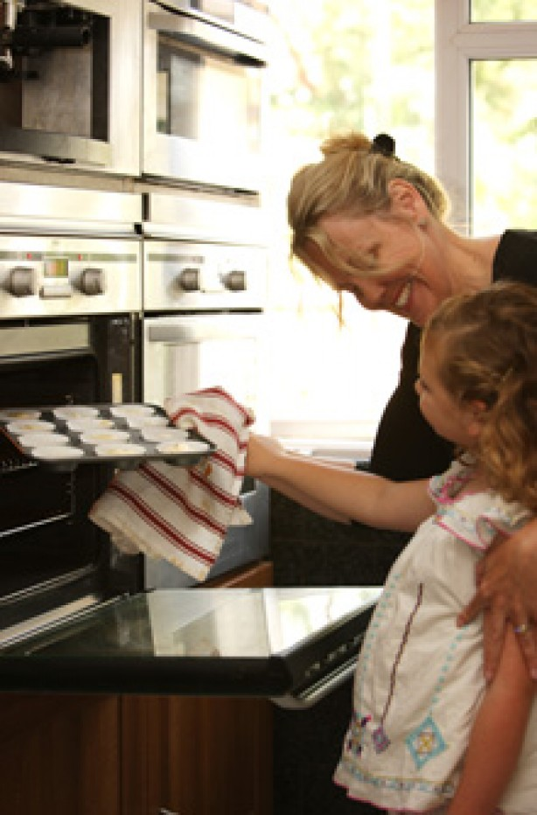
10) After that bake the buns for 12-15 mins until risen and golden.

Slide 12
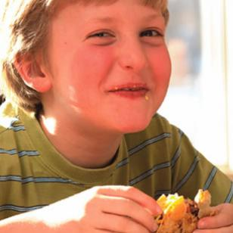
11) Finally, enjoy your beautifully baked bun!

