Slide 1
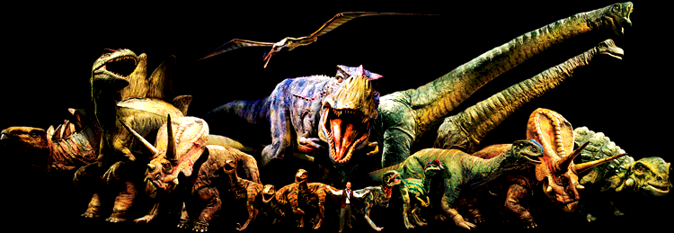
Dinosaurs
Aaliyah Rehman

Slide 2
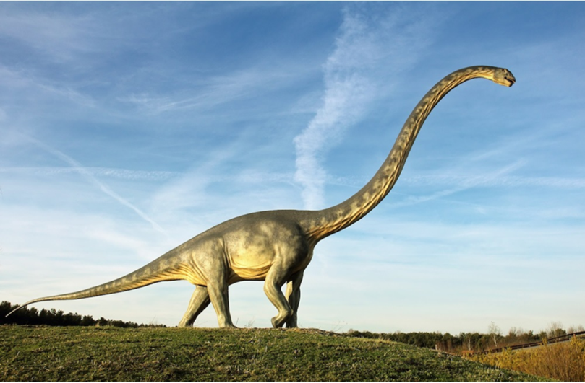

Slide 3
Diplodocus!
The meaning of their name is Double Beamed lizard.
They are the longest known dinosaur ever!
Their length was up to 27 meters and they also have a weight of more than 12 tons!
Diplodocus lived in an area that is now western North America at the end of the Jurassic Period, around 150 million years ago.
Diplodocus were plant eaters ( Herbivores ) that grazed in large herds together.
They had peg like teeth and ate things like trees, bushes, cycads, gingkoes and ferns.
You pronounce their name dip-lod-ic-uss.

Slide 4
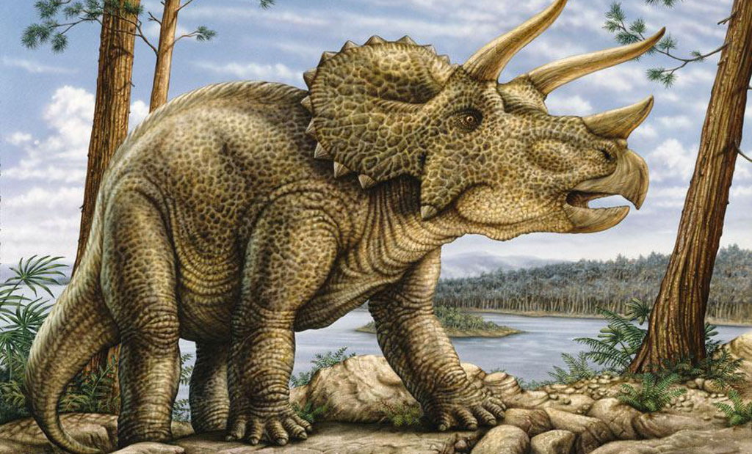

Slide 5
Triceratops!
Triceratops were plant eaters (herbivores) which grazed in large herds together.
They lived about 68 to 65 million years ago in the cretaceous period.
it had two long brow horns. These could grow to be at least 1 metre long.
Its dinosaur name means three horned face.
Triceratops were 9 metres in length and weighed 5 tons!
They lived in Upland Forest of North America.
Triceratops had nose horns they used for defence.
You pronounce their name tri-sera-tops.
To defend itself against meat eaters (predators) it had two long brow horns. These could grow to be at least 1 metre long.

Slide 6
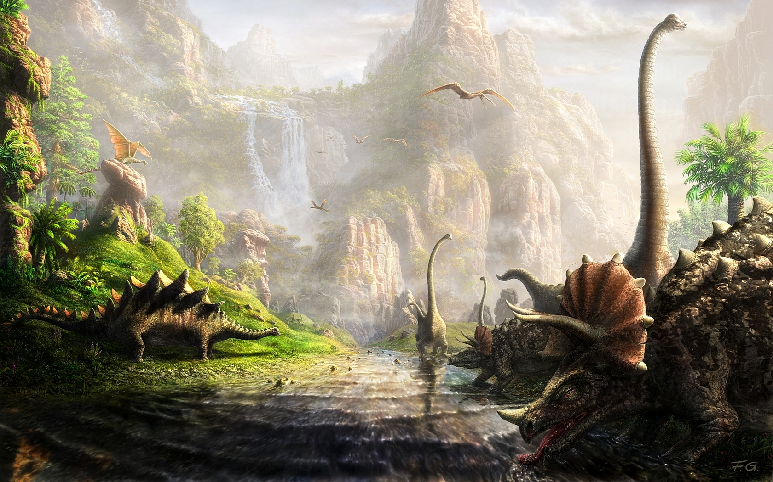
Thanks everyone for watching my fact file on dinosaurs I hope you enjoyed have a good day!

