Slide 1
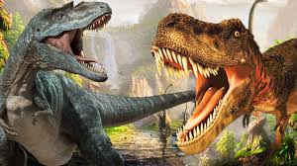
DINOSAURS!!!
By Arela

Slide 2
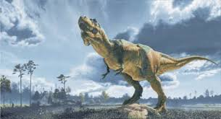
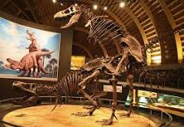
THE TYRANNOSAURUS REX
The Tyrannosaurus Rex also known as a T-rex has a life span of about 30 years.
A T-rex is a carnivore which means meat-eater.
The word tyrant lizard means a T-rex in Greece.
Birds were much like Tyrannosaurus rex because they couldn’t use their wings to eat and they had to use their heads instead.
T-rex’s skeletons were normally found in North American river valleys and forests.

Slide 3
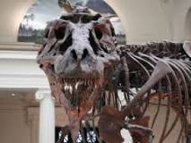
T-rex grew to12.3 meters (40 ft).
One of the T-rex relatives the Yutyrannus huali has filamentous feathers.
T-rex defend themselves with their sharp teeth because they are predators.
They could consume nearly 500 pounds of meat and they were one of the biggest meat eaters.
The Tyrannosuarus Rex lived in the craterous period.

Slide 4
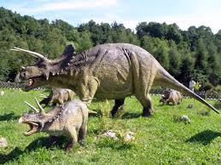
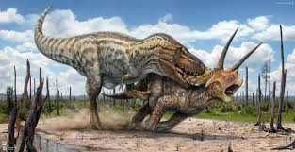
THE TRICERATOPS
Triceratops are a herbivore.
Herbivores eat plants and leafs and grass, they can eat these because of their flat teeth.
They have 3 horns. One on their nose and the last 2 on their heads.
They used their front horn for defence and to defend its young from predators.
This amazing dinosaur waded 5 tons and grew to 9 meters (30 feet). AMAZING and OUTSTANDING.

Slide 5
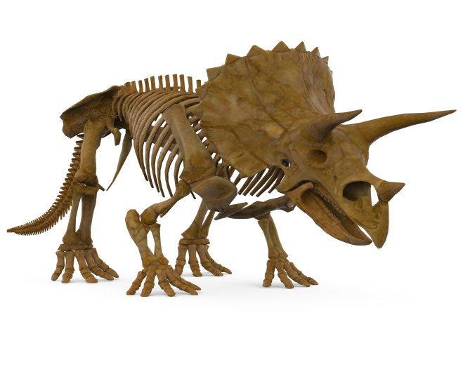
They lived in the Late Cretaceous Period.
They lived 67-68 million years ago.
They lived at the same time as the Tyrannosaurus rex, Albertosaurus and Spinosaurus.
The word triceratops means three horned face.
Some triceratops have bone nobs on their frills which makes it hard for their predators to bite them on their necks.

Slide 6
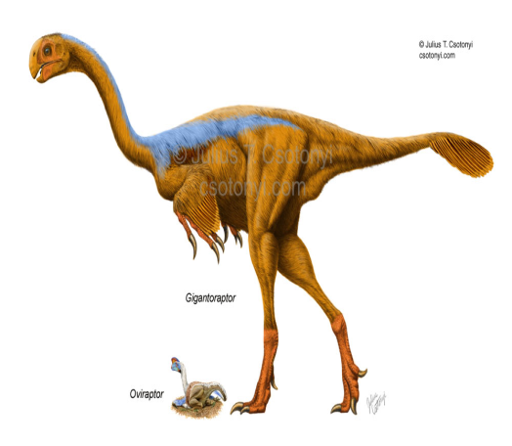
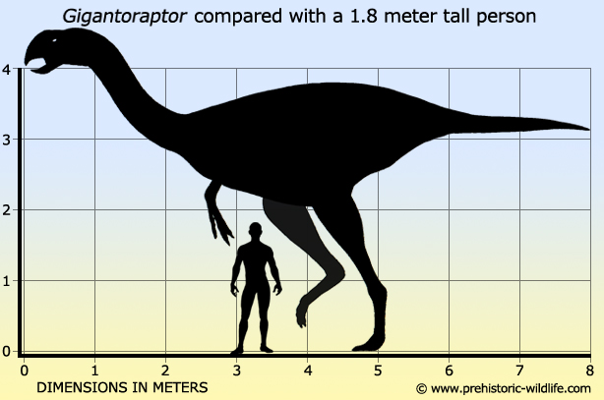
The
Gigantoraptor
A Gigantoraptor is a omnivore that can eat plants and meat which makes them a carnivore and a herbivore.
They grew to 8 meters ( 26 feet) and weighed 1400 kilograms.
They lived in china mostly and they were the largest feathered dinosaurs that ever lived to exist.
Nobody knows how they defend themselves. Tell me if you have an idea.

Slide 7
SO LONG EVERYONE!!!!!!

